Slide 1

[ BROKER LOGO ]
agentFORWARD
June 2026 Updates + NAR Sales Meeting Playbook

Slide 2
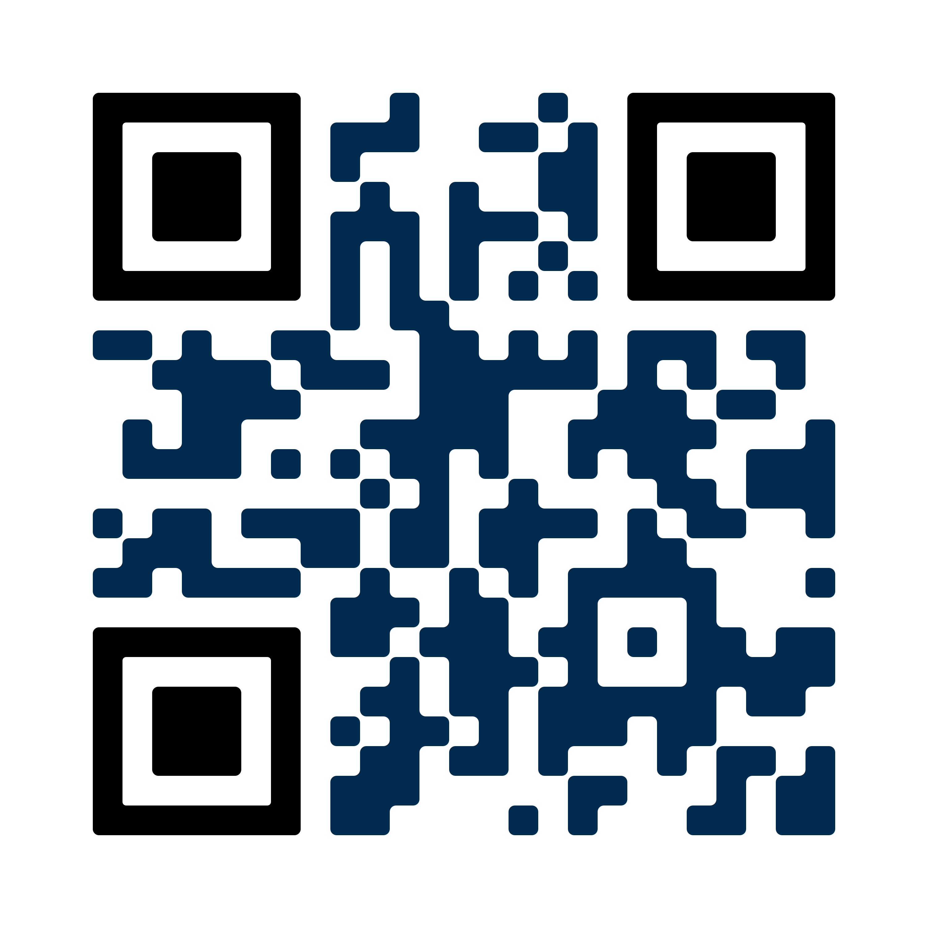

[ BROKER LOGO ]
agentFORWARD
RECENT FORM CHANGES
Get the details at texasrealestate.com/legalupdates

Slide 3
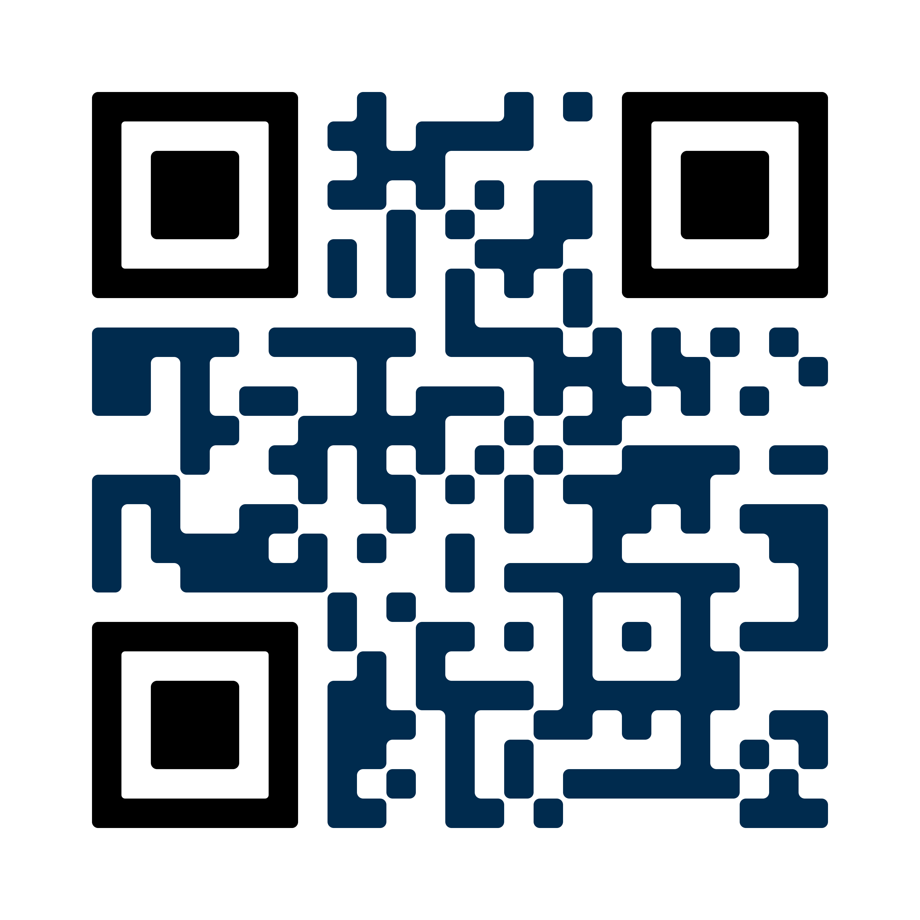
[ BROKER LOGO ]
agentFORWARD
VOLUNTEERING
Join a Texas REALTORS® Committee by June 30
Make a difference. Gain experience. Help your industry.
texasrealestate.com/countmein
20+ committees available!

Slide 4
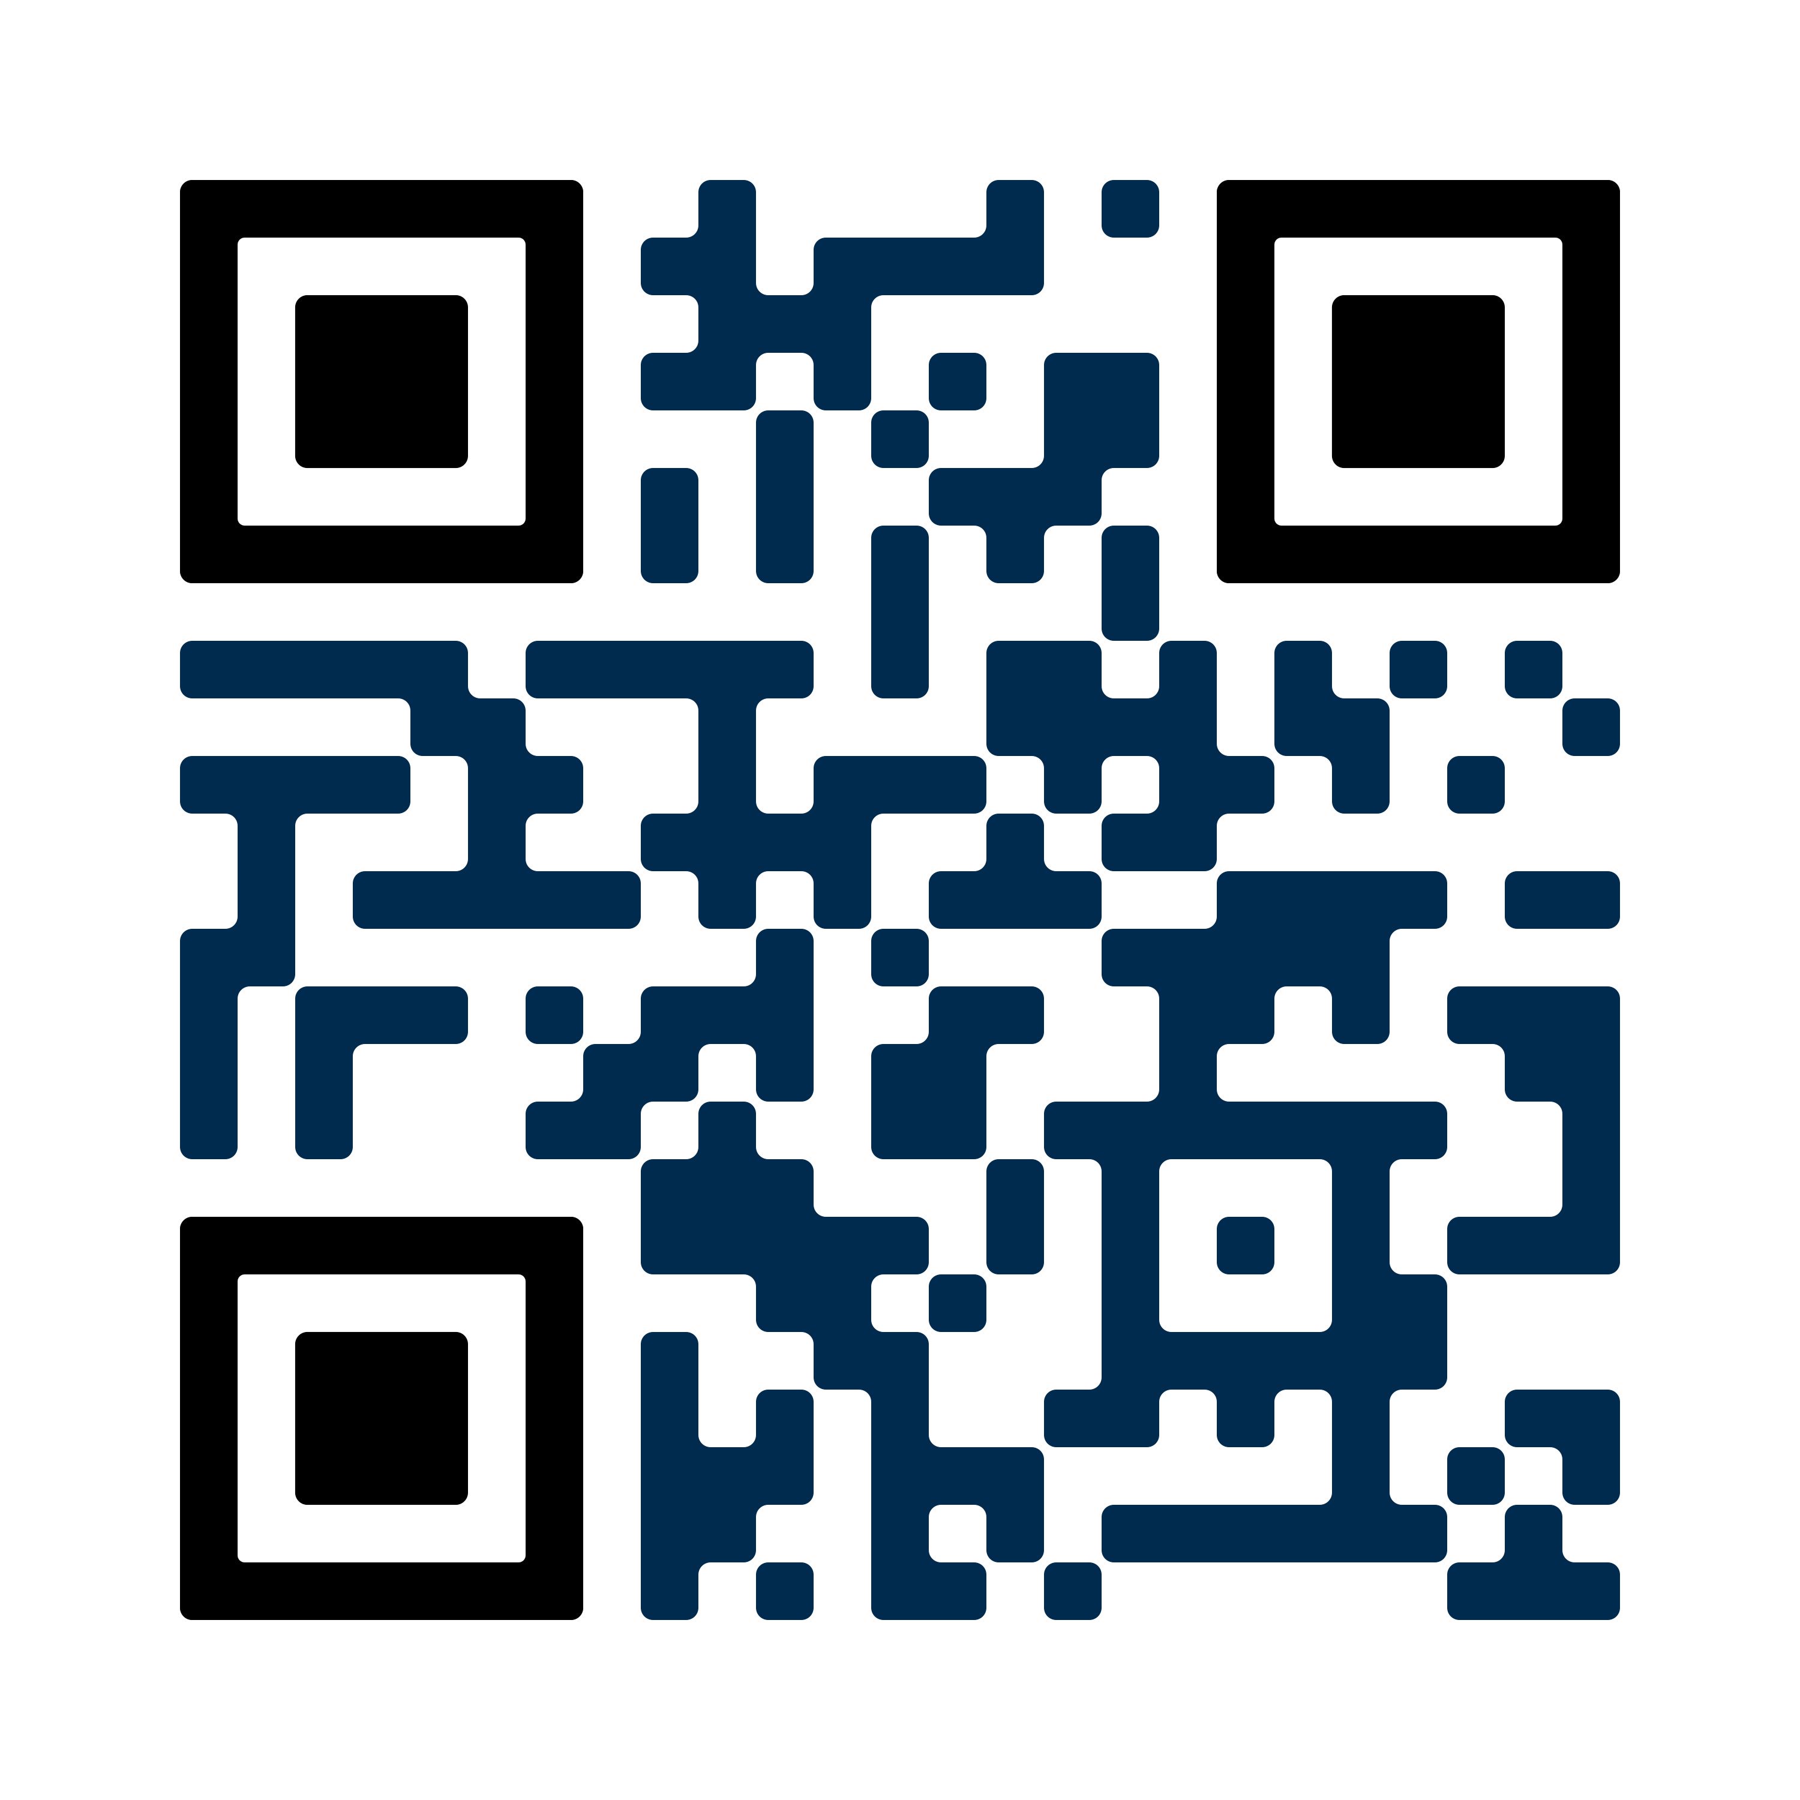
[ BROKER LOGO ]
agentFORWARD
2026 SHAPING TEXAS CONFERENCE
August 27-30
Grand Hyatt San Antonio River Walk
REGISTER NOW at texasrealestate.com/conference

Slide 5
[ BROKER LOGO ]
agentFORWARD
CONFERENCE
Opening Session: John Quiñones
Broadcast journalist (“20/20”, “What Would You Do?”)
Networking and Social Opportunities
Hot topics include:
AI, professionalism, MLS, appraisals

Slide 6
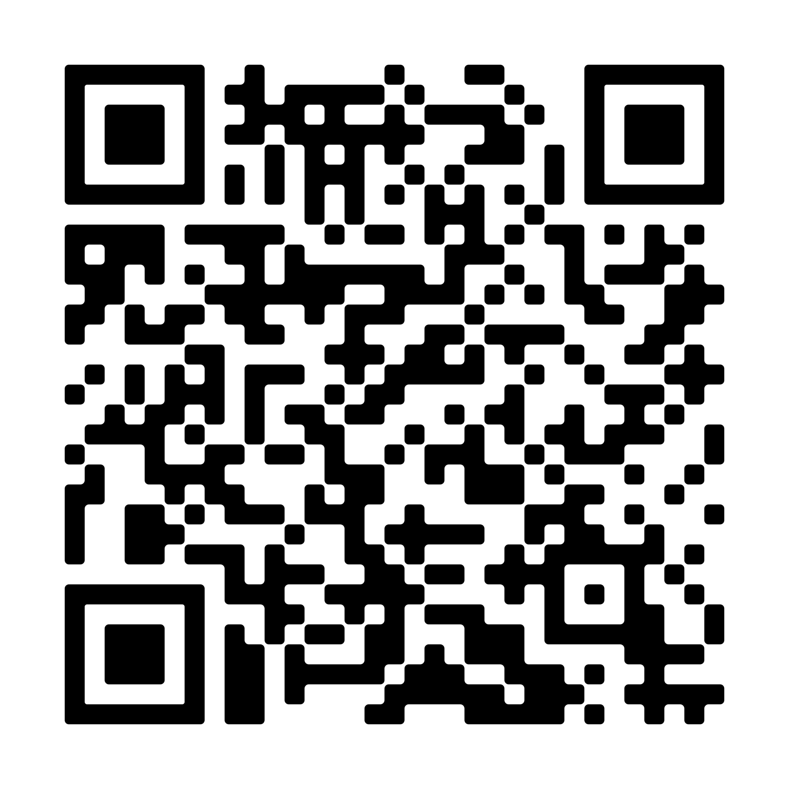
[ BROKER LOGO ]
agentFORWARD
ZIPFORM ON THE GO
Access zipForm on your phone
Transact is zipForm’s new, mobile friendly transaction management system
Learn more at texasrealestate.com/transact

Slide 7
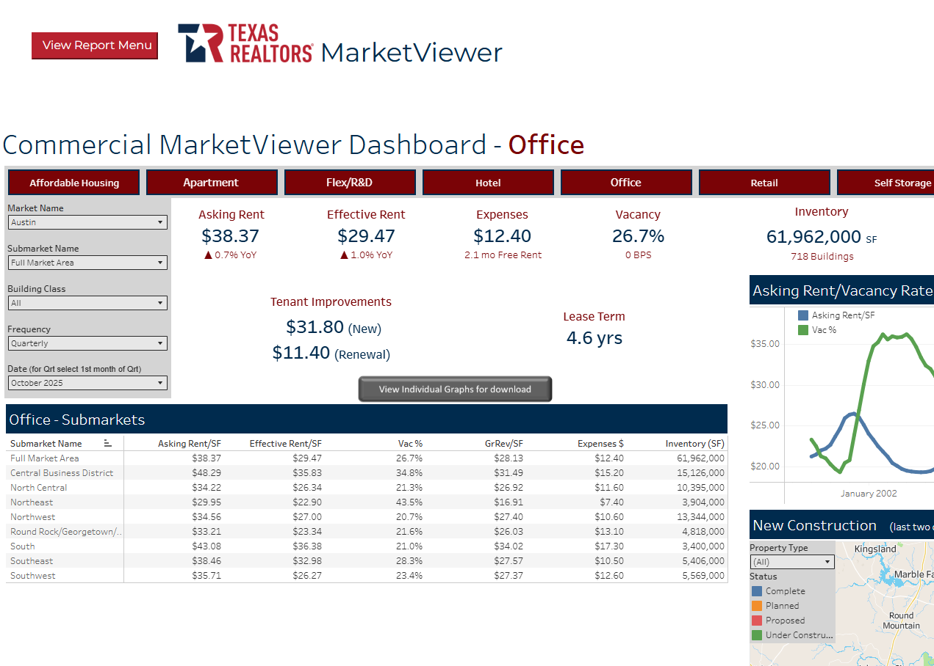
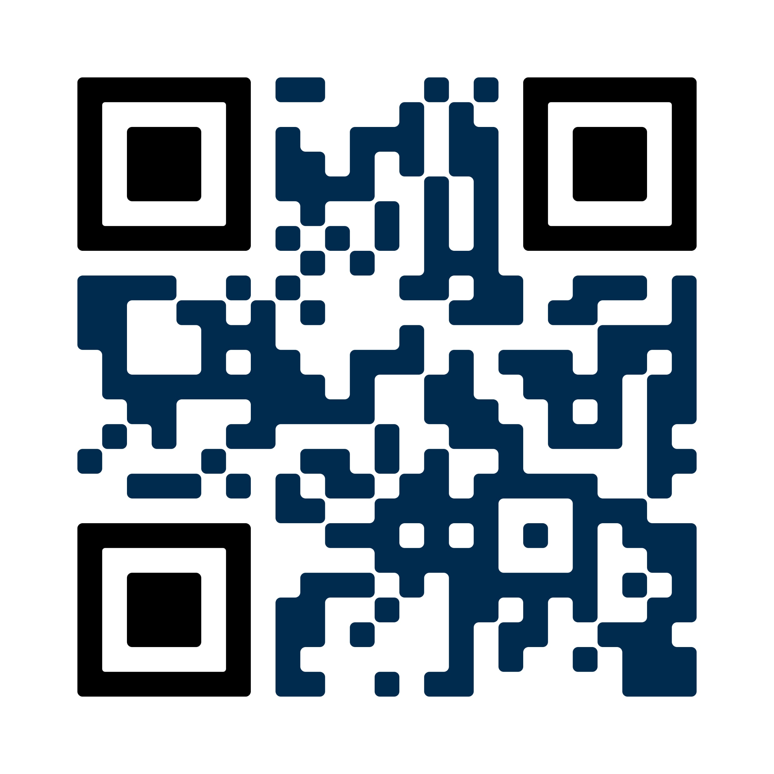
[ BROKER LOGO ]
agentFORWARD
MARKETVIEWER
Your exclusive database
Choose your geographic area
Spanish + Vietnamese translations
Create reports and infographics
Residential, commercial, farm & ranch
texasrealestate.com/marketviewer

Slide 8
[ BROKER LOGO ]
agentFORWARD
Find this and other resources at texasrealestate.com/brokers

