Slide 1

[ BROKER LOGO ]
agentFORWARD
August 2026 Updates + NAR Sales Meeting Playbook

Slide 2
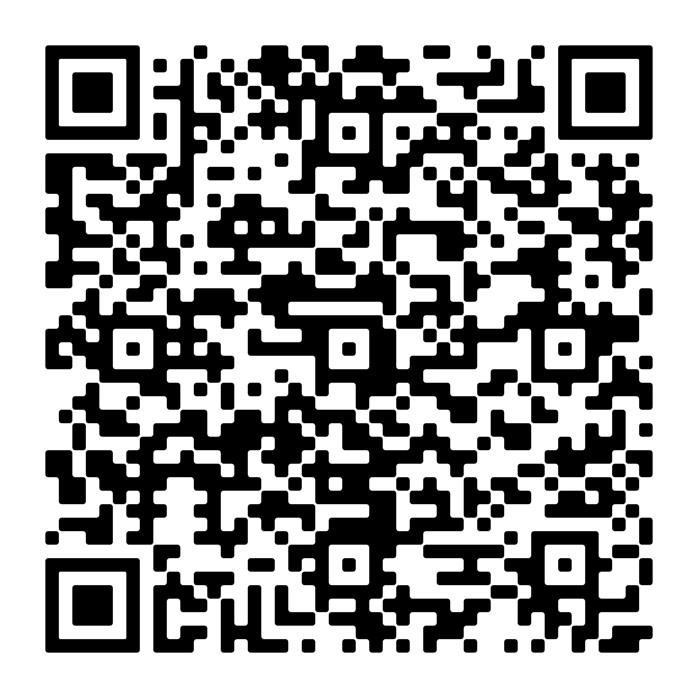

[ BROKER LOGO ]
agentFORWARD
YPN
Don’t Miss This Safety Webinar
Vulnerable to Vigilant: Practical Safety Strategies for Real Estate Professionals
September 16 at 9 a.m. Central
This one-hour safety course will transform how you
approach your daily field operations.
Sign up: texasrealestate.com/members/events/event-list/

Slide 3
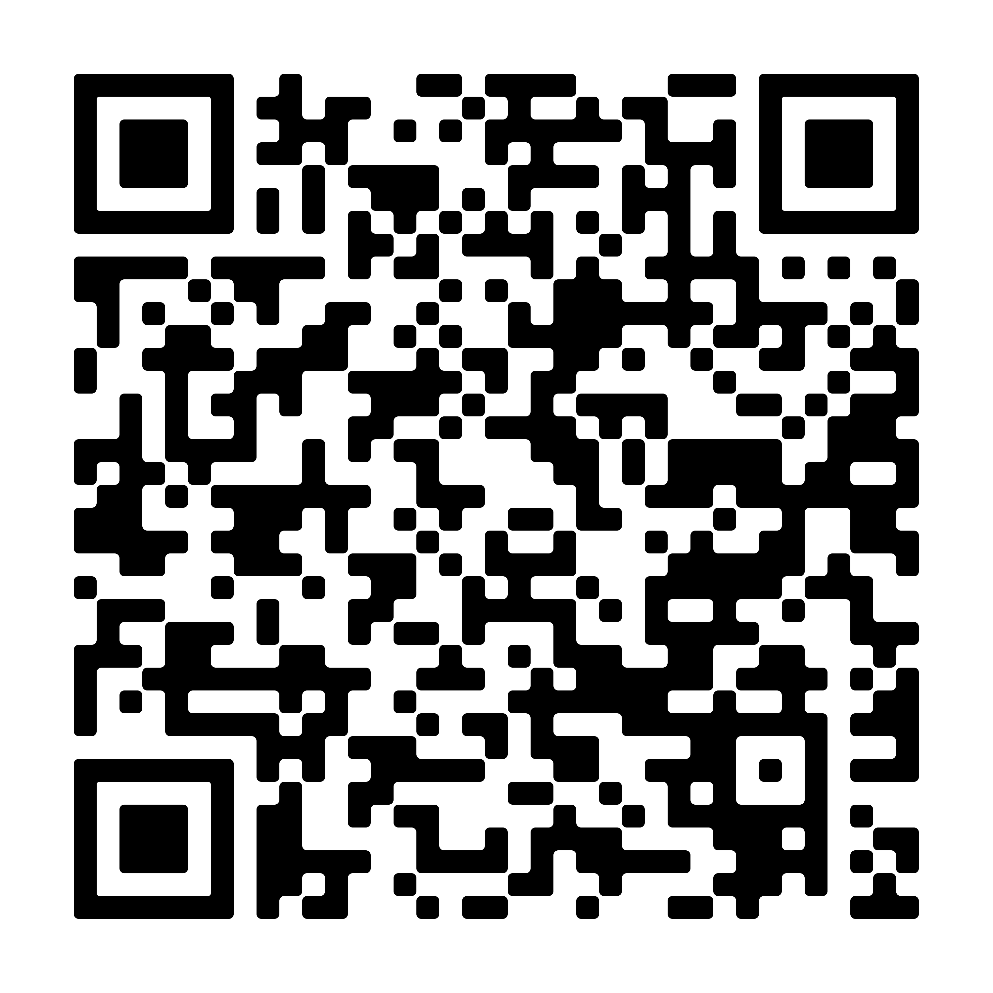
[ BROKER LOGO ]
agentFORWARD
2026 Texas International Residential Transactions Report
Learn what foreign buyers are looking for,
what they’re buying,
how they’re paying,
and more!
Check out all the reports at texasrealestate.com/members/research

Slide 4
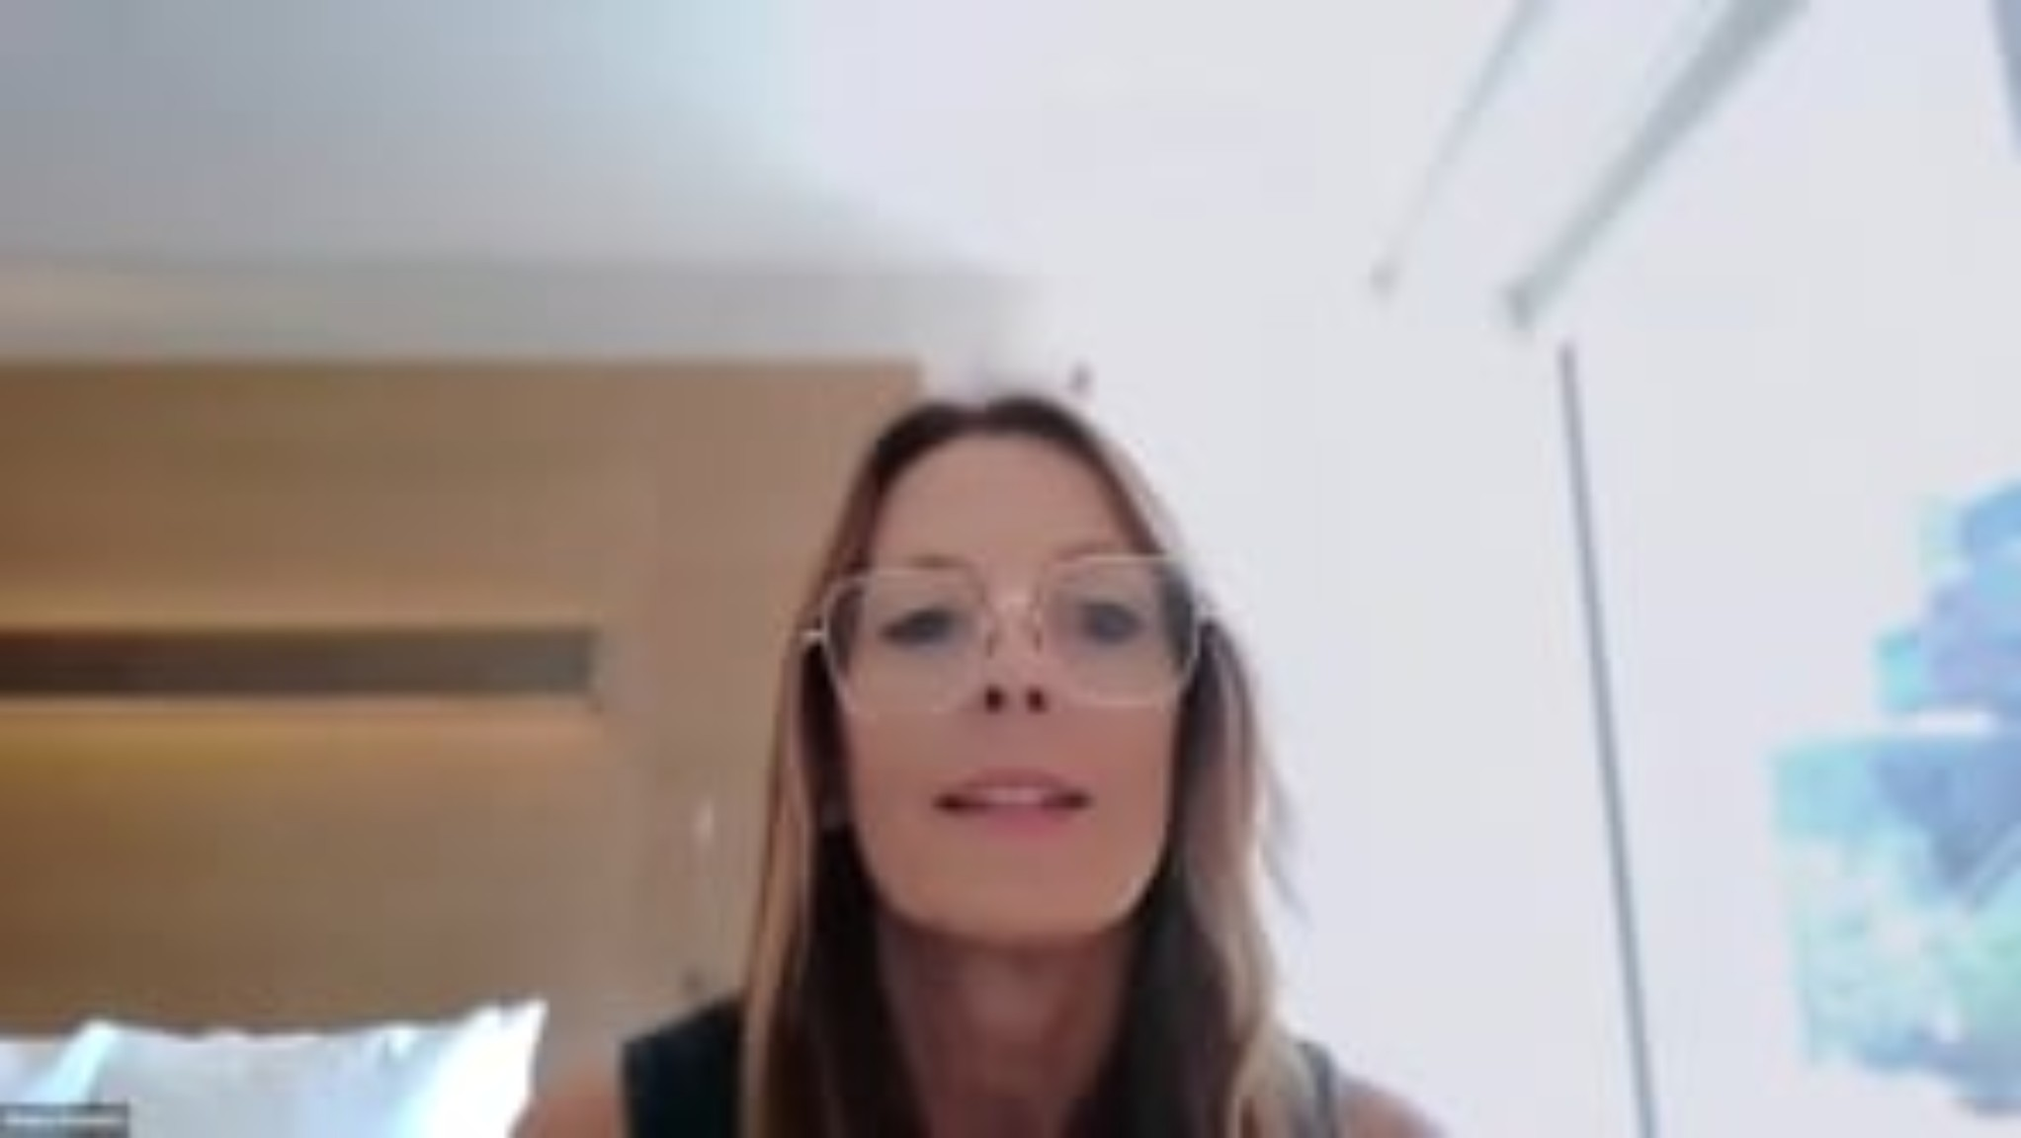
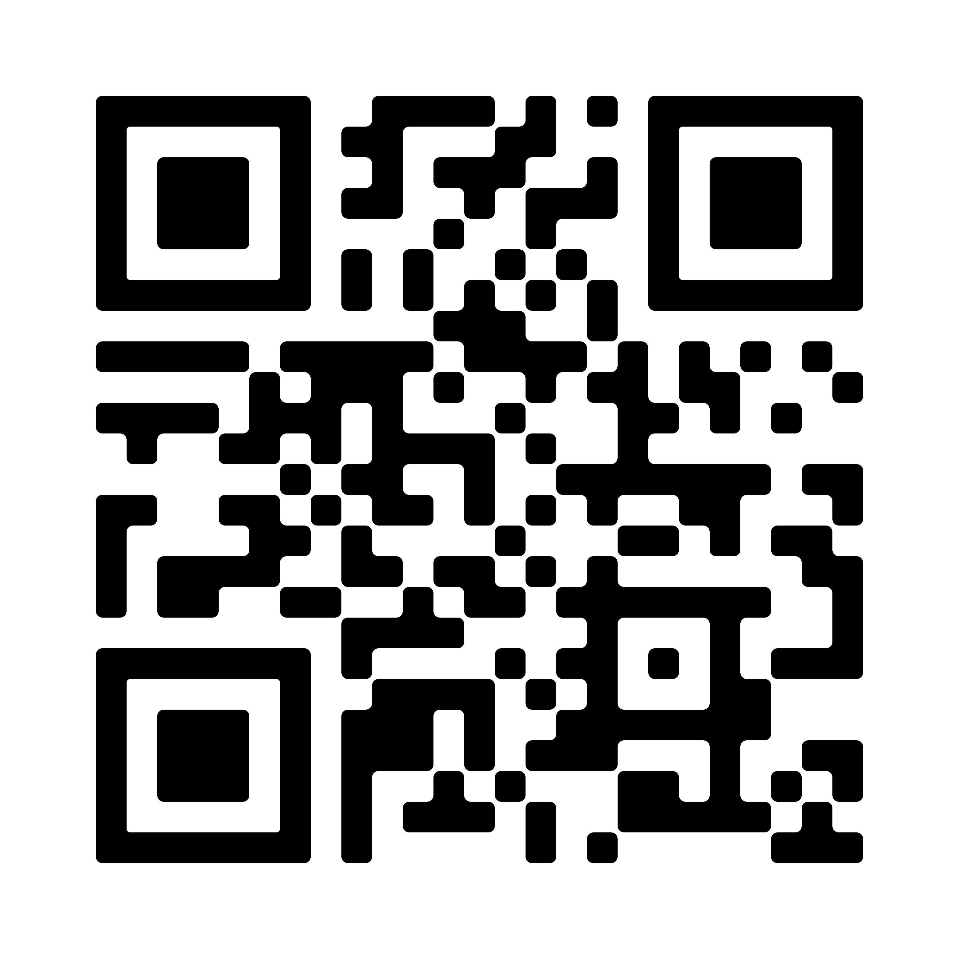
[ BROKER LOGO ]
agentFORWARD
YPN
What You Need to Know About Appraisal Changes
This webinar explains how these changes will affect you and your clients.
Watch at vimeo.com/1215860663

Slide 5
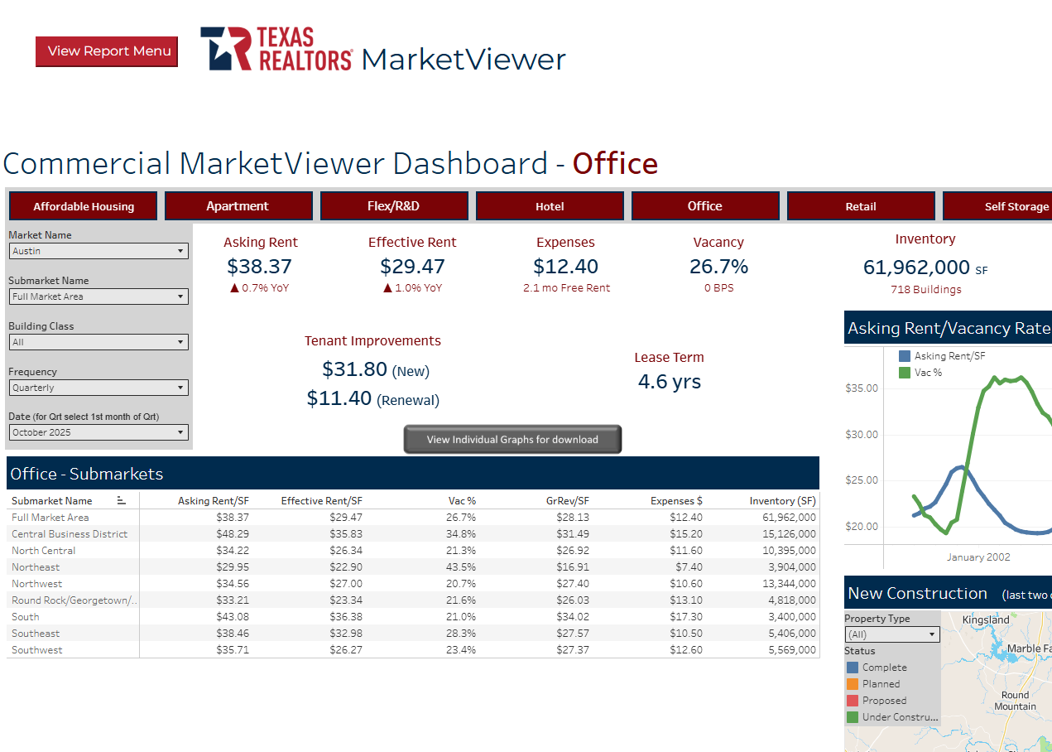
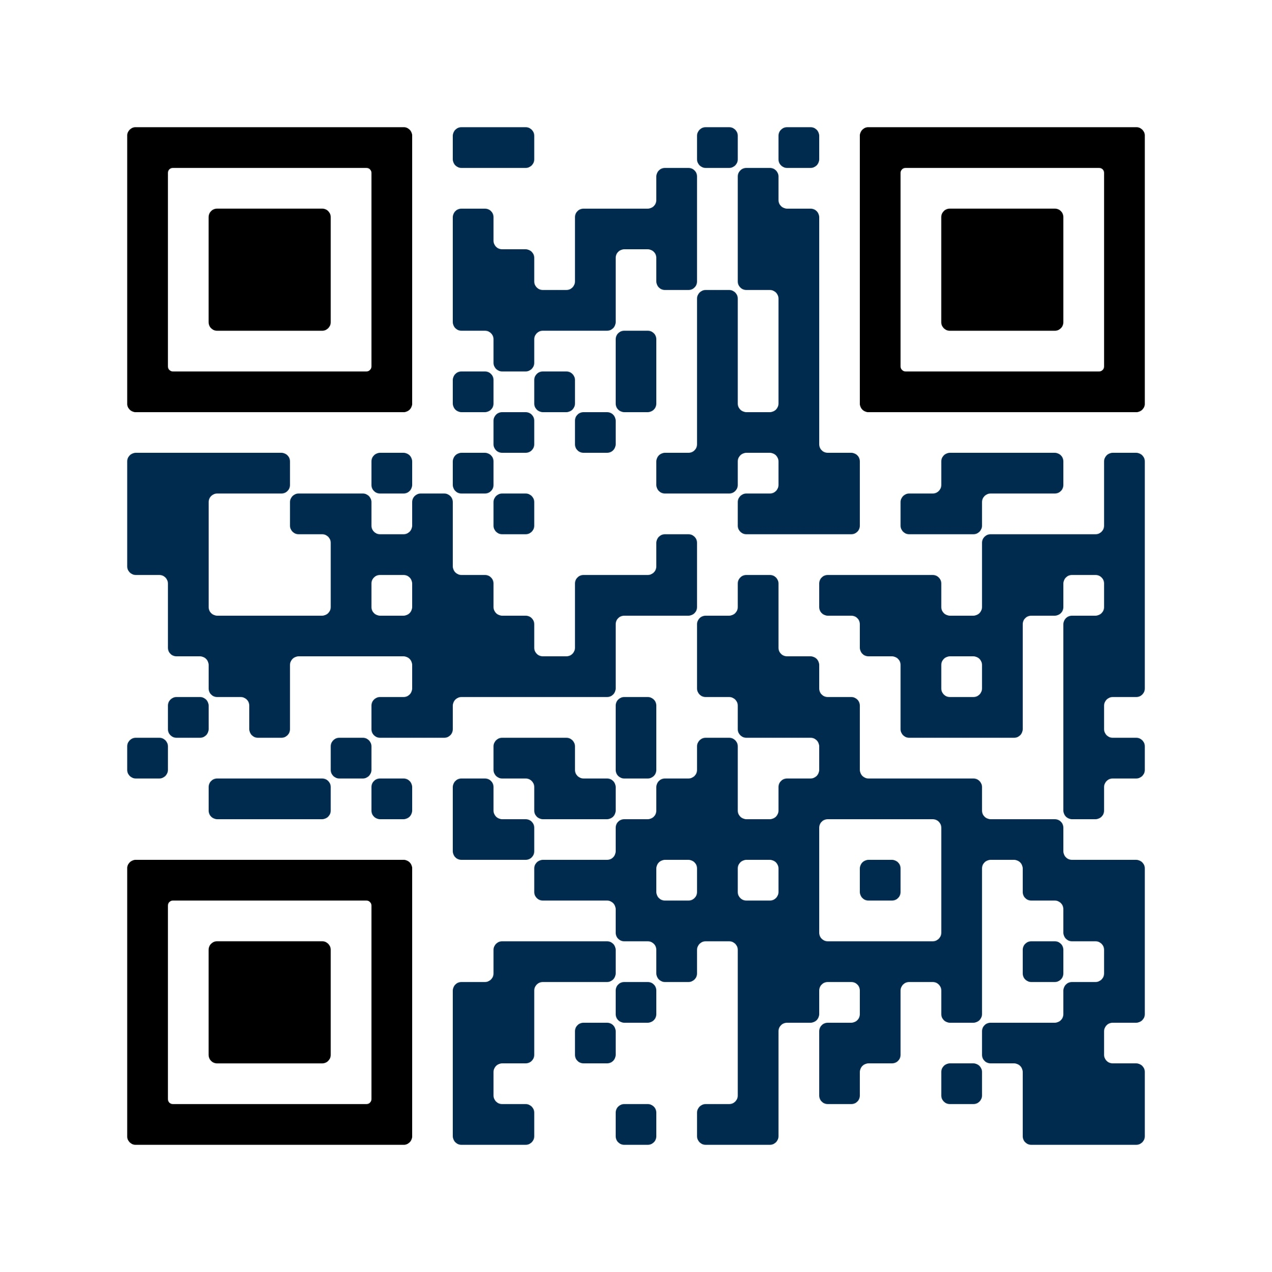
[ BROKER LOGO ]
agentFORWARD
MARKETVIEWER
Your exclusive database
Choose your geographic area
Spanish + Vietnamese translations
Create reports and infographics
Residential, commercial, farm & ranch
July Statistics Now Available!
texasrealestate.com/marketviewer

