Slide 1

agentFORWARD
[ BROKER LOGO ]
agentFORWARD
Creating a Business Plan

Slide 2

agentFORWARD
[ BROKER LOGO ]
Help Your Agents Build a Business Plan
From the Graduate, REALTOR® Institute Course
GRI Real Estate Brokerage
From the Graduate, REALTOR® Institute Course, GRI Real Estate Brokerage

Slide 3
agentFORWARD
[ BROKER LOGO ]
A business plan has several key components.
Putting some of these ideas down on paper will help you think about which qualities you possess that will help you serve others.
The items below will serve as a guide as you decide exactly what services you’ll provide, and who you’ll provide them to.
From the Graduate, REALTOR® Institute Course, GRI Real Estate Brokerage

Slide 4
agentFORWARD
[ BROKER LOGO ]
Audience
Who you’ll reach, who you’ll serve, and who your services will ultimately affect. Don’t forget to include prospects and your community involvement or participation.
EXAMPLE “I work with and get a lot of referrals from the high-tech companies in our area.”
From the Graduate, REALTOR® Institute Course, GRI Real Estate Brokerage

Slide 5
agentFORWARD
[ BROKER LOGO ]
Mission Statement
A brief, overall summary of how you operate.
EXAMPLE “My mission is to provide an experience that will make the client feel comfortable giving me a referral.”
From the Graduate, REALTOR® Institute Course, GRI Real Estate Brokerage

Slide 6
agentFORWARD
[ BROKER LOGO ]
Philosophy
A mindset of how you feel you should treat your customers. This can be both an overall approach and specific actions and can be tailored as you find your niche.
EXAMPLE “I believe that initial verbal customer contact lies at the heart of a successful transaction. If a customer contacts me via email, I always follow up by phone first to establish the relationship.”
From the Graduate, REALTOR® Institute Course, GRI Real Estate Brokerage

Slide 7
agentFORWARD
[ BROKER LOGO ]
Goals and Objectives
An idea of what you want to achieve, and benchmarks that allow you to gauge your progress.
GOAL “My goal is to sell three homes in neighborhoods where I haven’t ever sold homes.”
OBJECTIVE “Farm a new area that I’m interested in—send out cards and deliver calendars.”
From the Graduate, REALTOR® Institute Course, GRI Real Estate Brokerage

Slide 8
agentFORWARD
[ BROKER LOGO ]
Assets
Skills, attributes, or abilities that either make you great at what you do, make you critical to the transaction, or set you apart from others.
EXAMPLE “Buyer side: My ability to listen and identify my customer’s needs helps me minimize the property search by selecting properties that closely meet my buyer’s criteria.”
From the Graduate, REALTOR® Institute Course, GRI Real Estate Brokerage

Slide 9
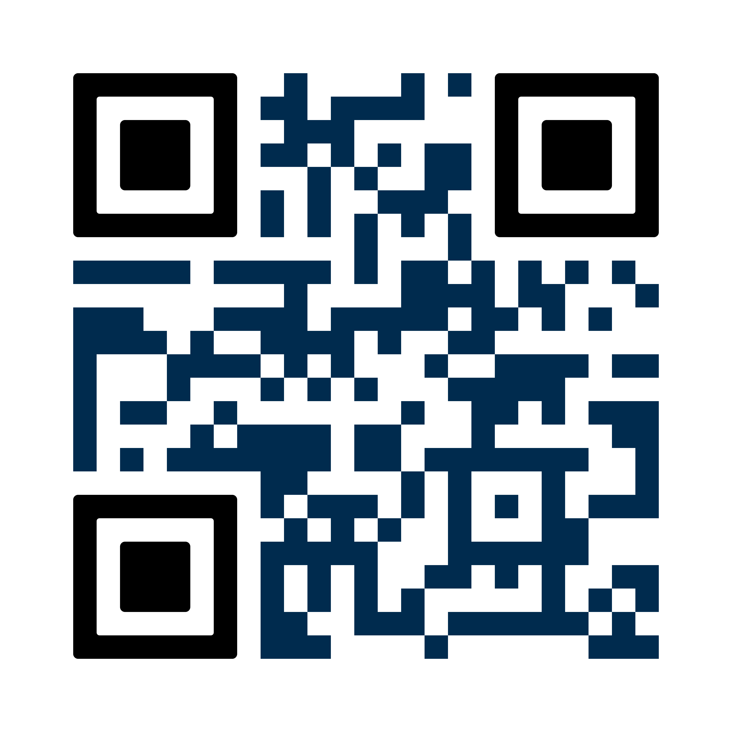
agentFORWARD
[ BROKER LOGO ]
For more tips like these, take the GRI Real Estate Brokerage course and earn the Graduate, REALTOR® Institute designation.
94% of REALTORS® in Texas with their GRI designation recommend it to other REALTORS®. The GRI coursework includes information about contracts, marketing and business skills, and real estate brokerage.
FOR MORE INFORMATION, SCAN THIS QR CODE OR VISIT
texasrealestate.com/gri

