Slide 1

[ BROKER LOGO ]
agentFORWARD
July 2026 Updates + NAR Sales Meeting Playbook

Slide 2
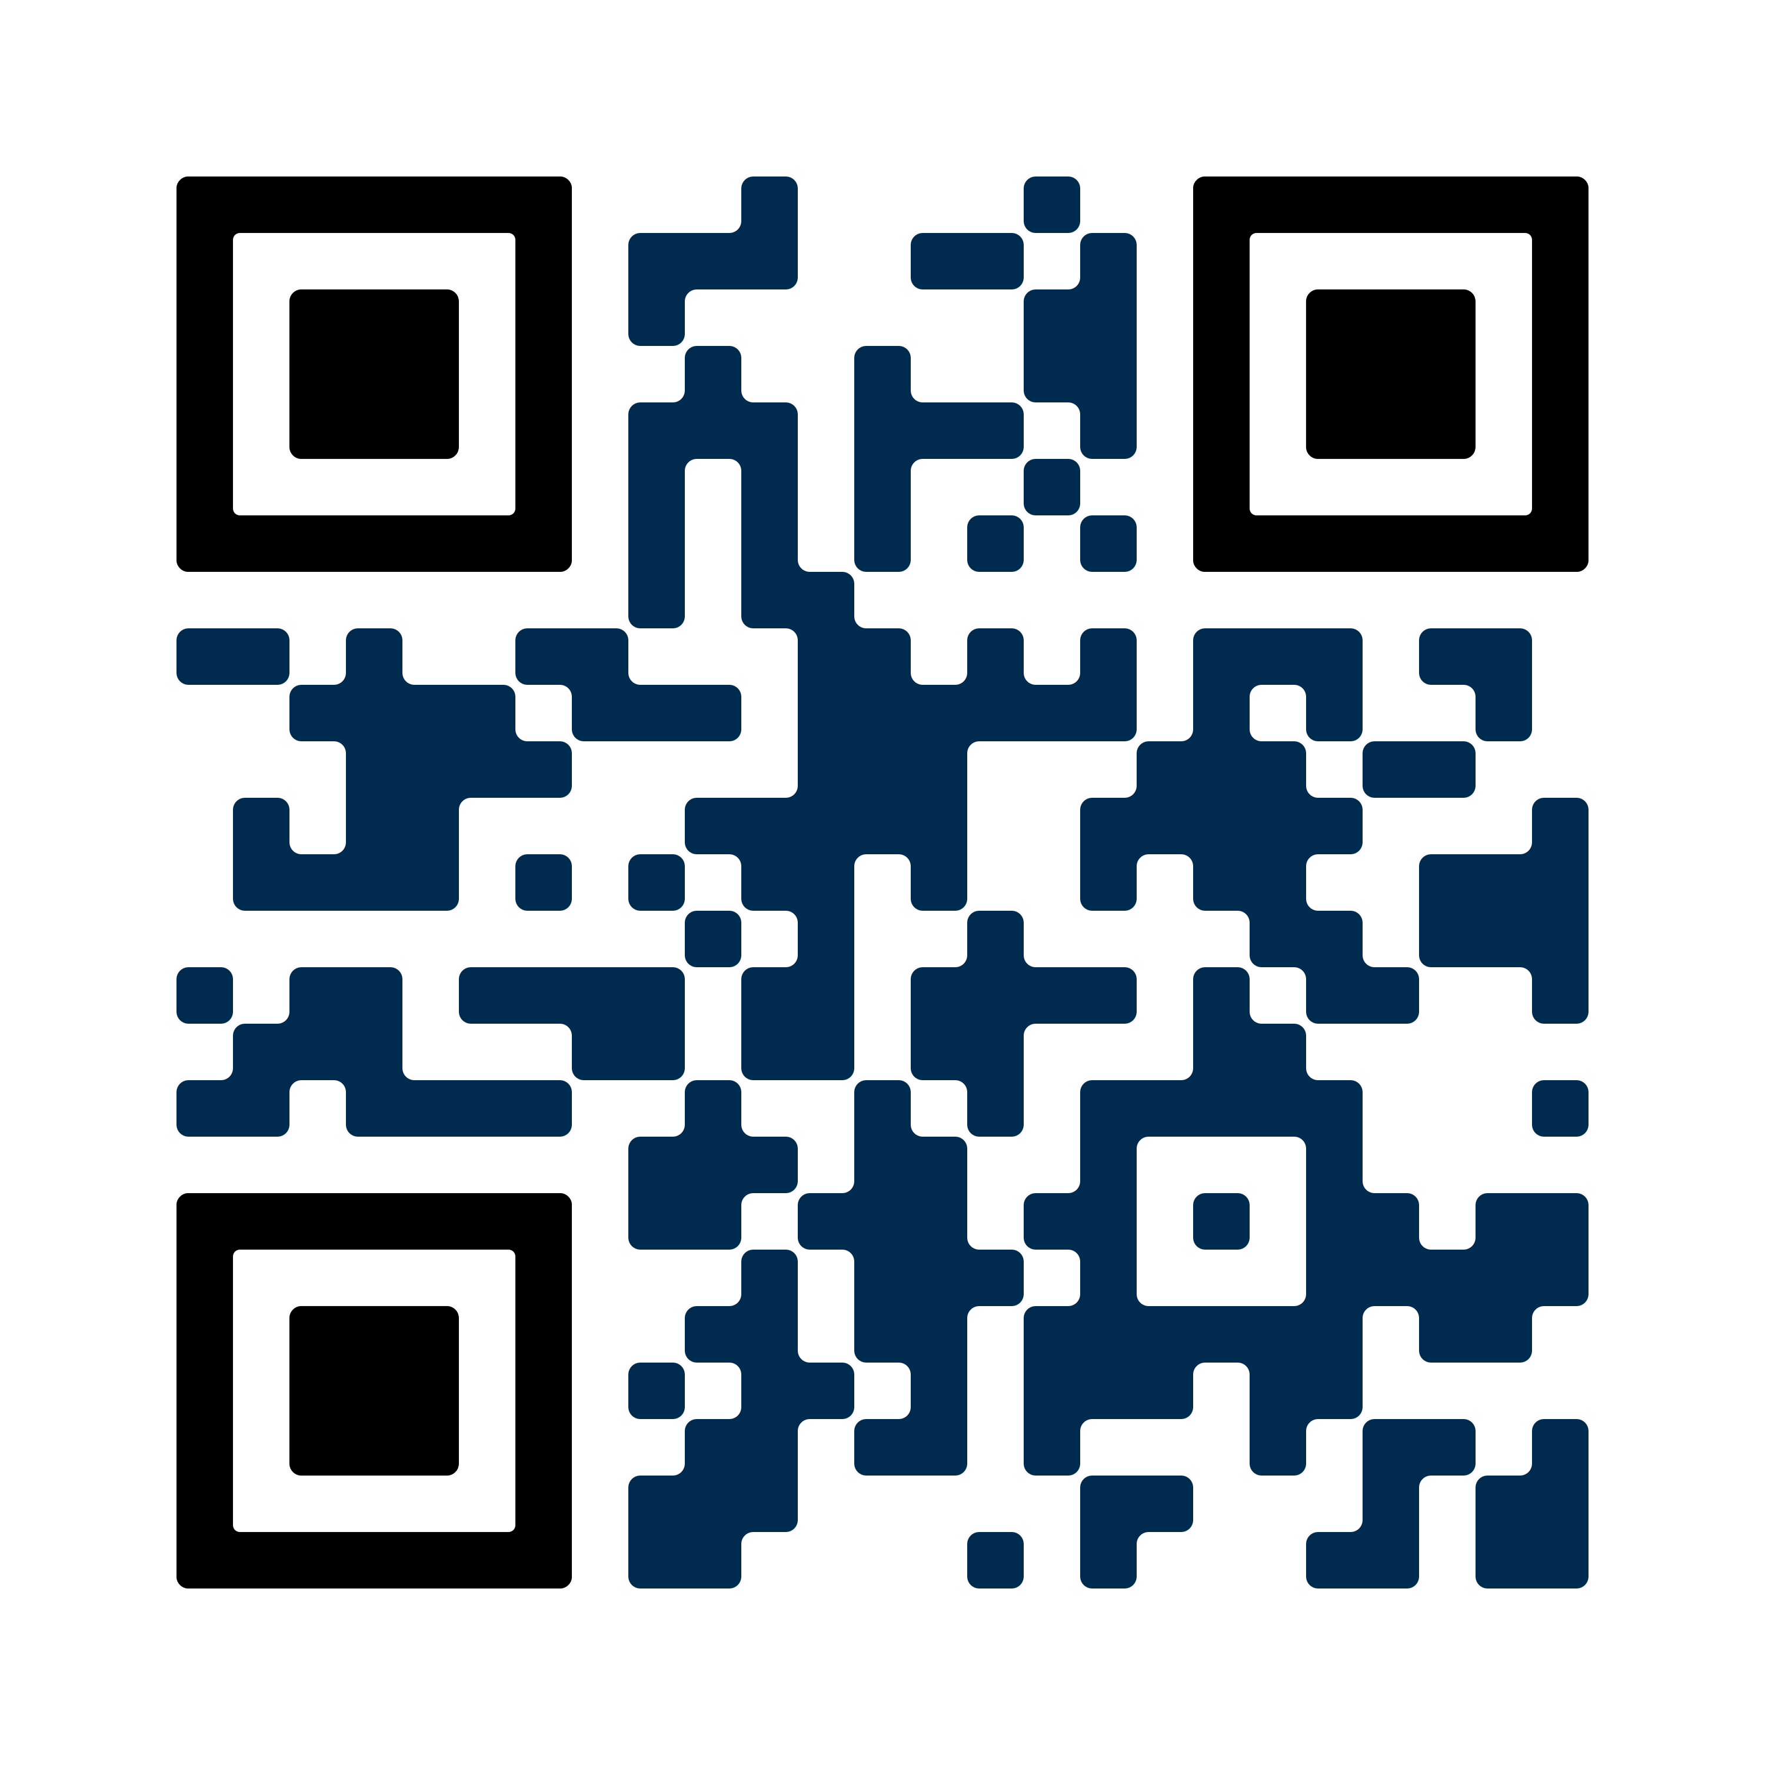

[ BROKER LOGO ]
agentFORWARD
Texas REALTORS® Legal Updates
Keep up with the latest forms changes
Frequently Asked Questions
A PDF summary of what’s new
Stay updated at texasrealestate.com/legalupdates

Slide 3
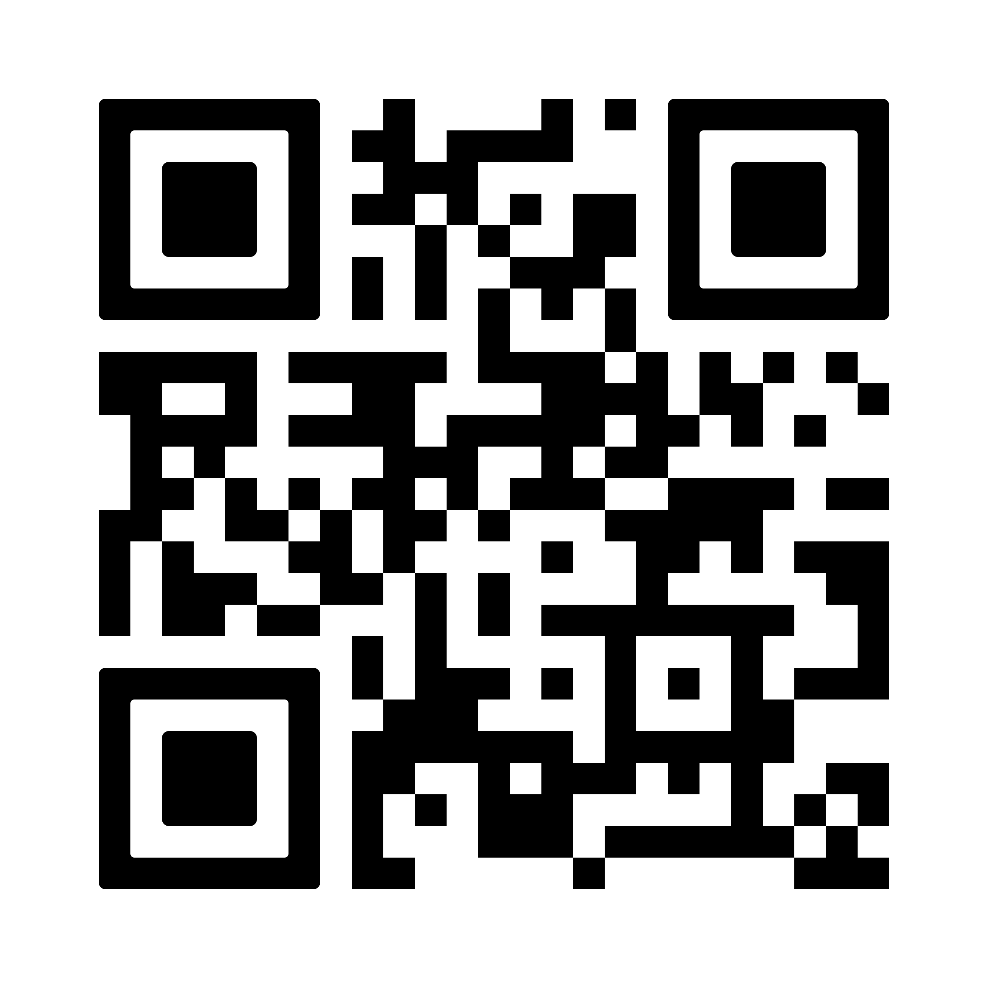
[ BROKER LOGO ]
agentFORWARD
YPN
Data Center Resources
Texas REALTORS® put together this resource guide to help you talk to your local elected officials to understand what is being proposed.
Read more at:
texasrealestate.com/datacenters

Slide 4
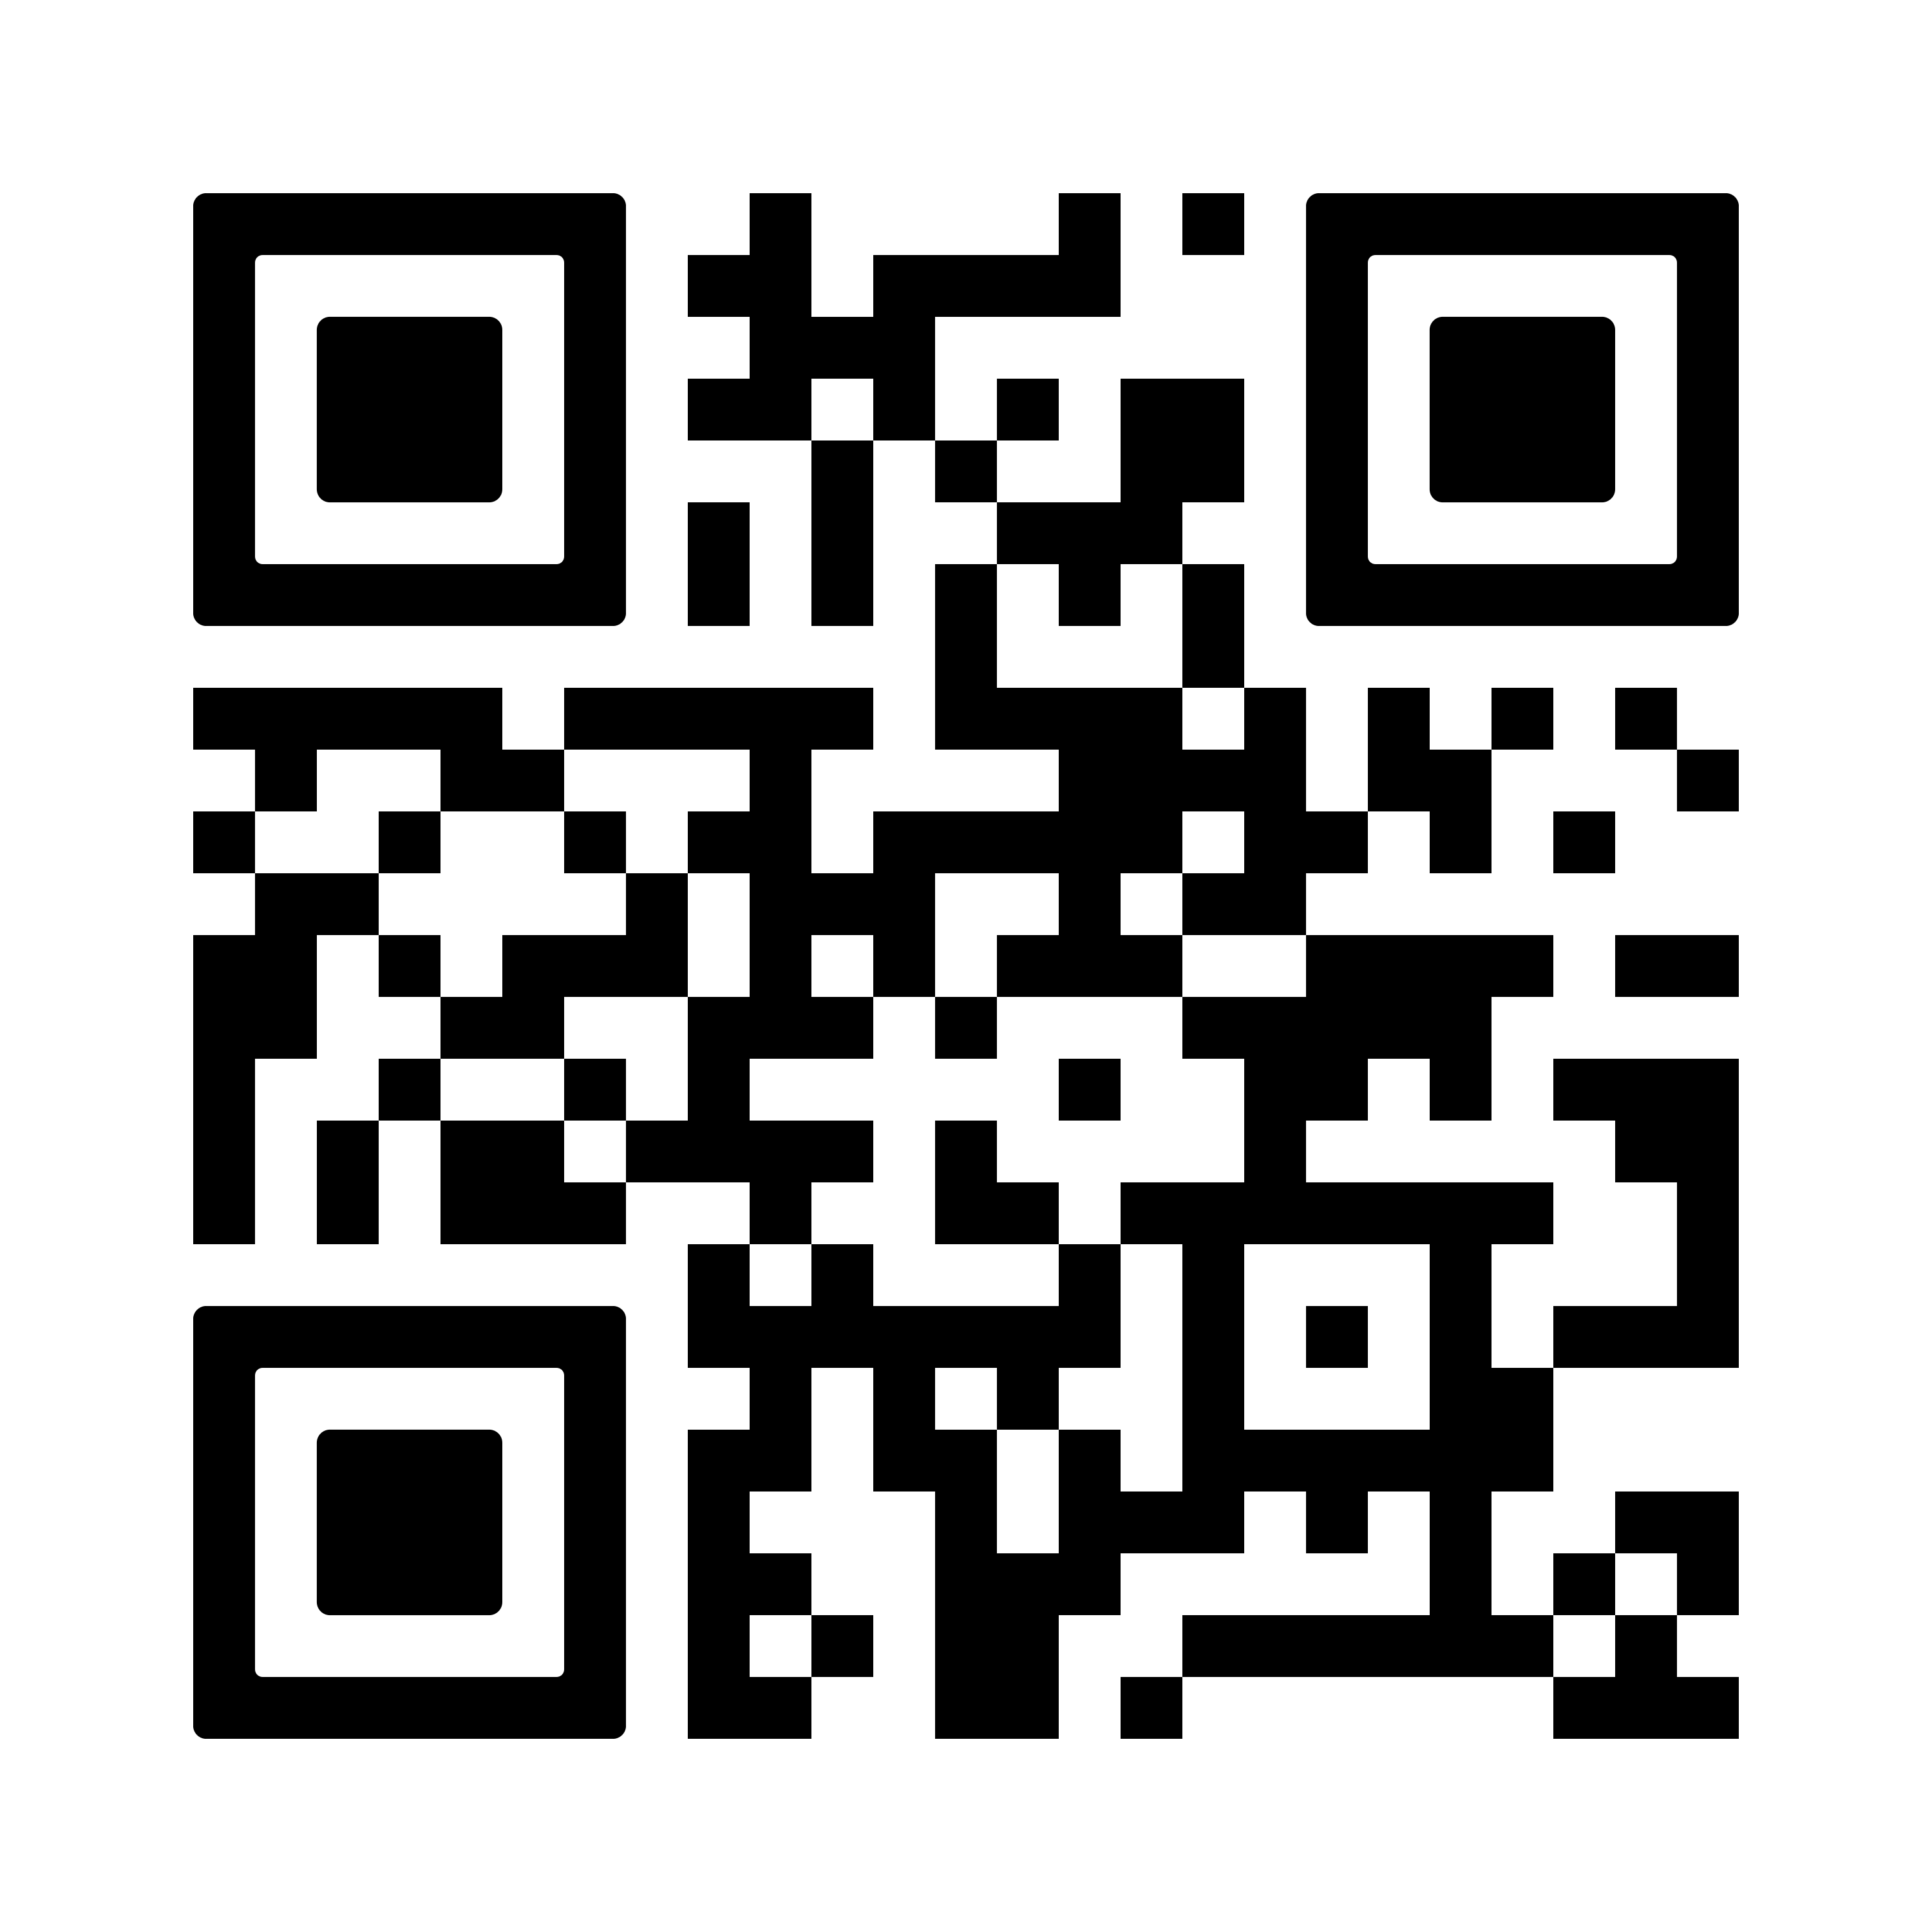
[ BROKER LOGO ]
agentFORWARD
YPN
Upcoming Virtual Think Tank Webinars
SEPTEMBER 9
If Real Estate Is Your Profession, Politics Is Your Business
DECEMBER 16
Learn from Experience, Lead with Confidence: The Power of Mentorship
9:30 a.m. Central on Zoom
Register at
texasrealestate.com/members/events/event-list

Slide 5



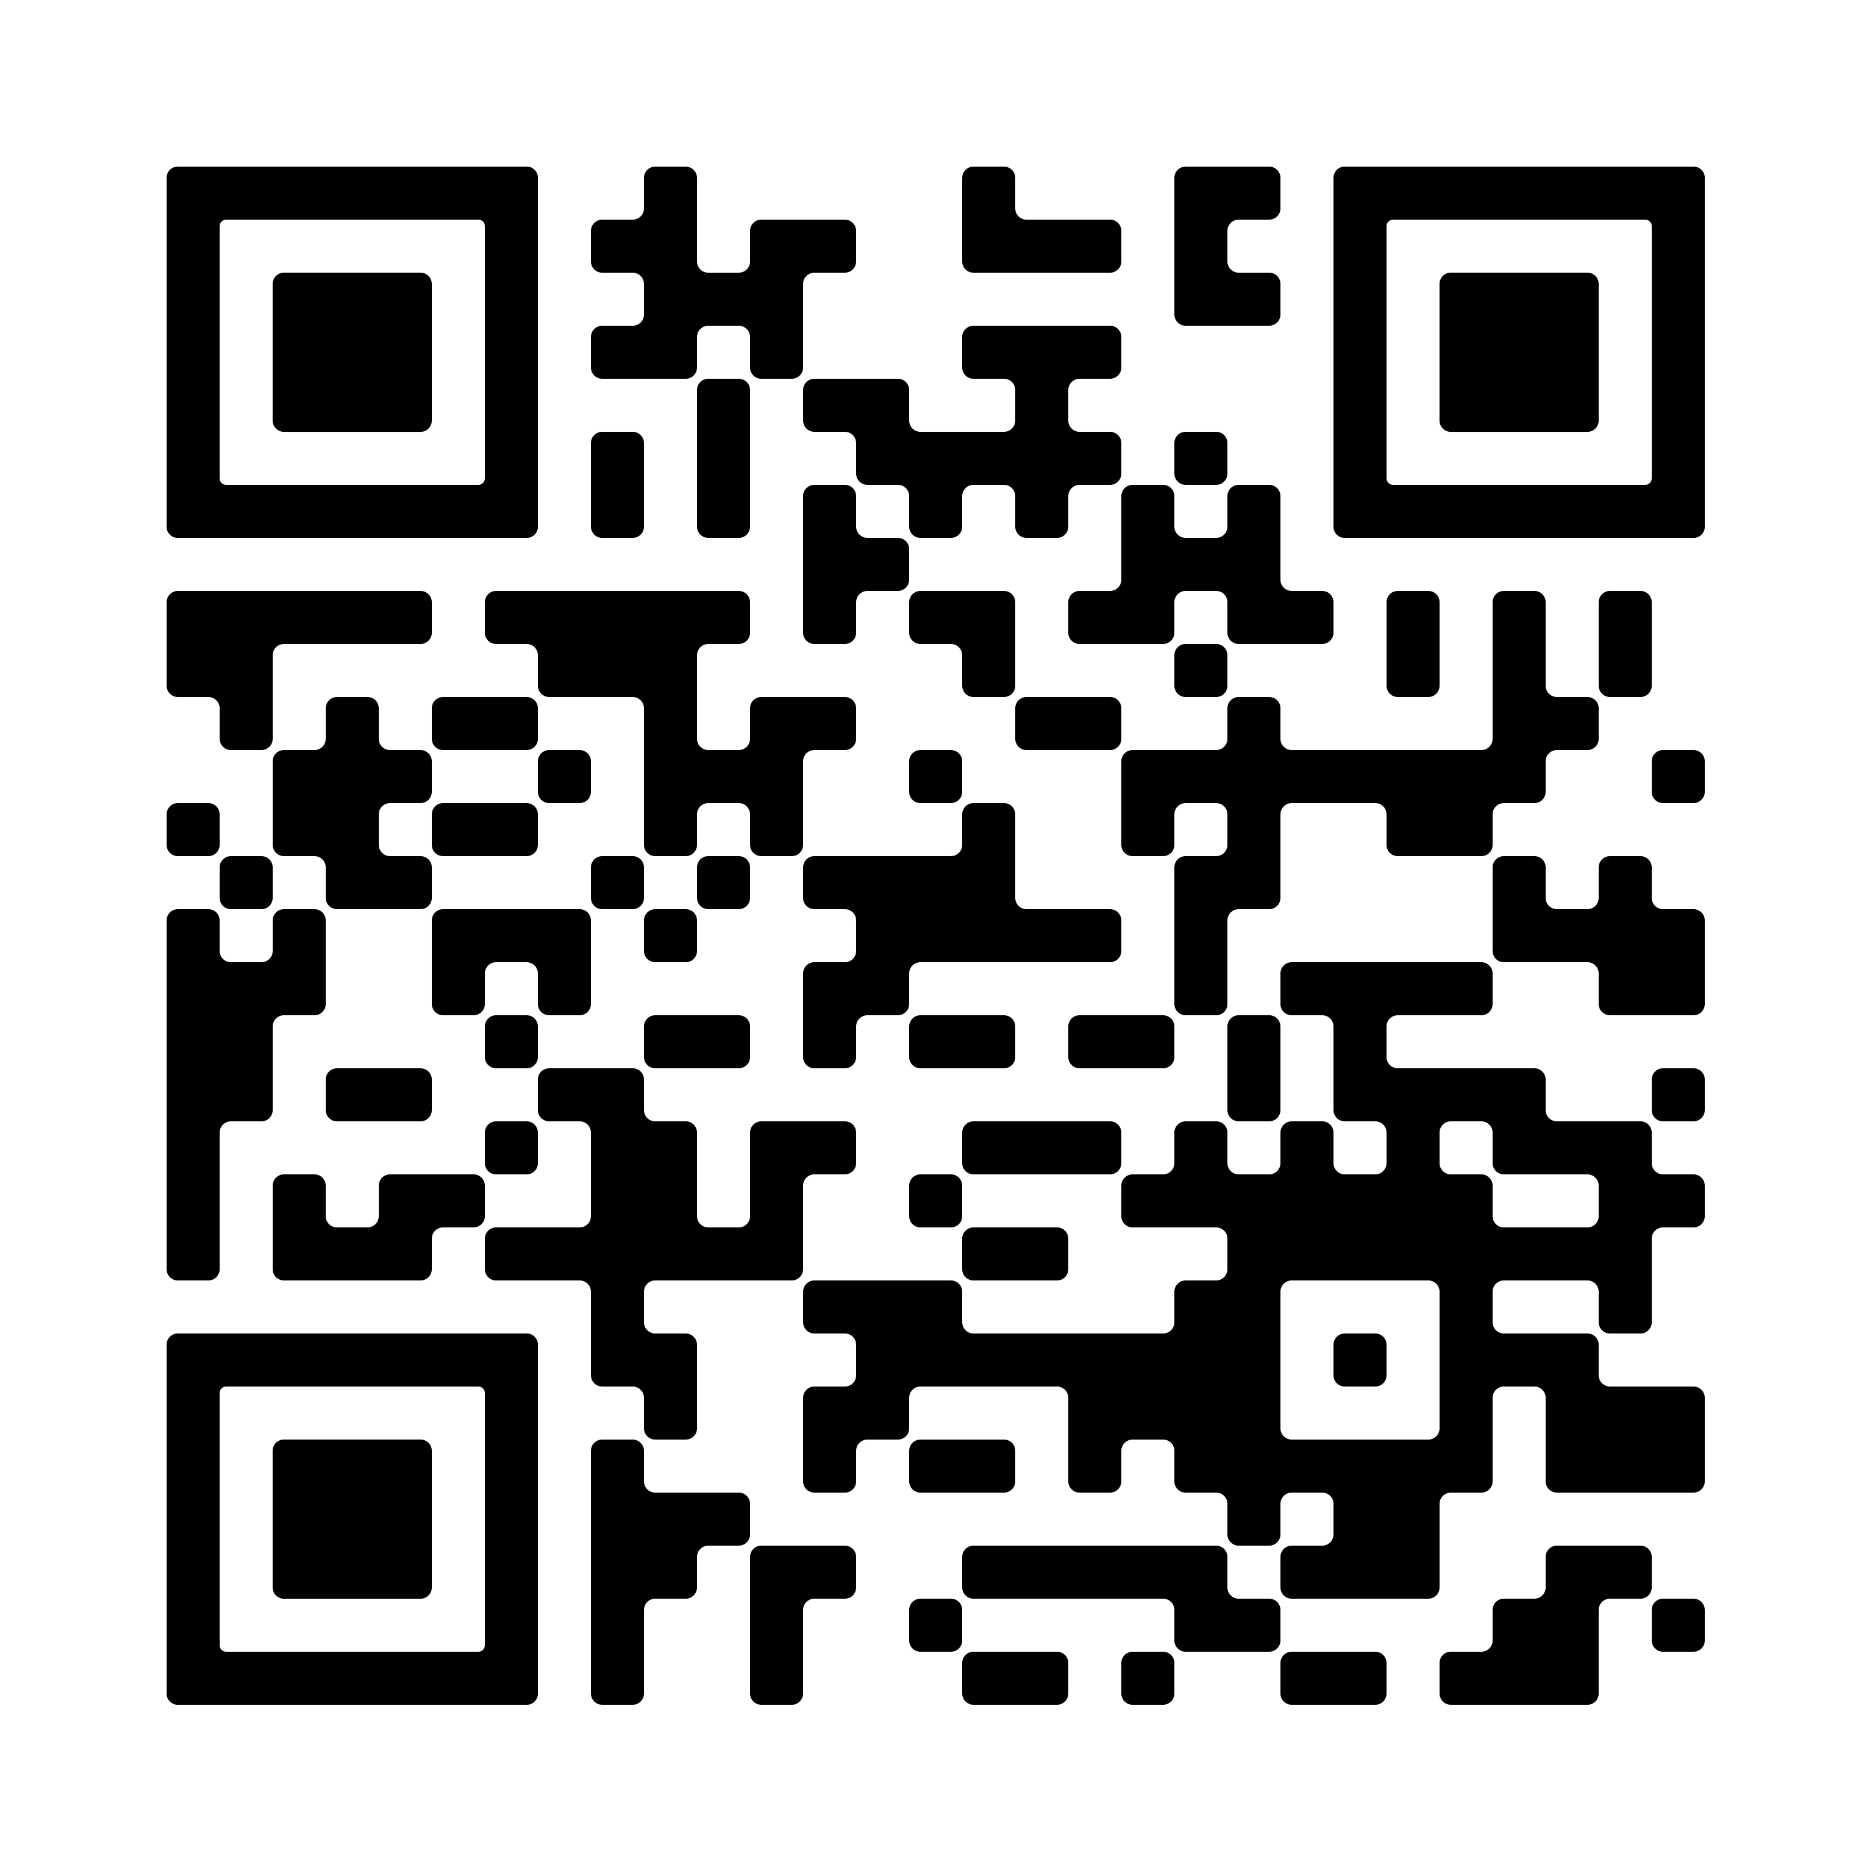
[ BROKER LOGO ]
agentFORWARD
New Ads Support Your Business
Click the photos to watch, or see more at Vimeo: vimeo.com/showcase/12320870
(You may have to enable content before sharing)

Slide 6
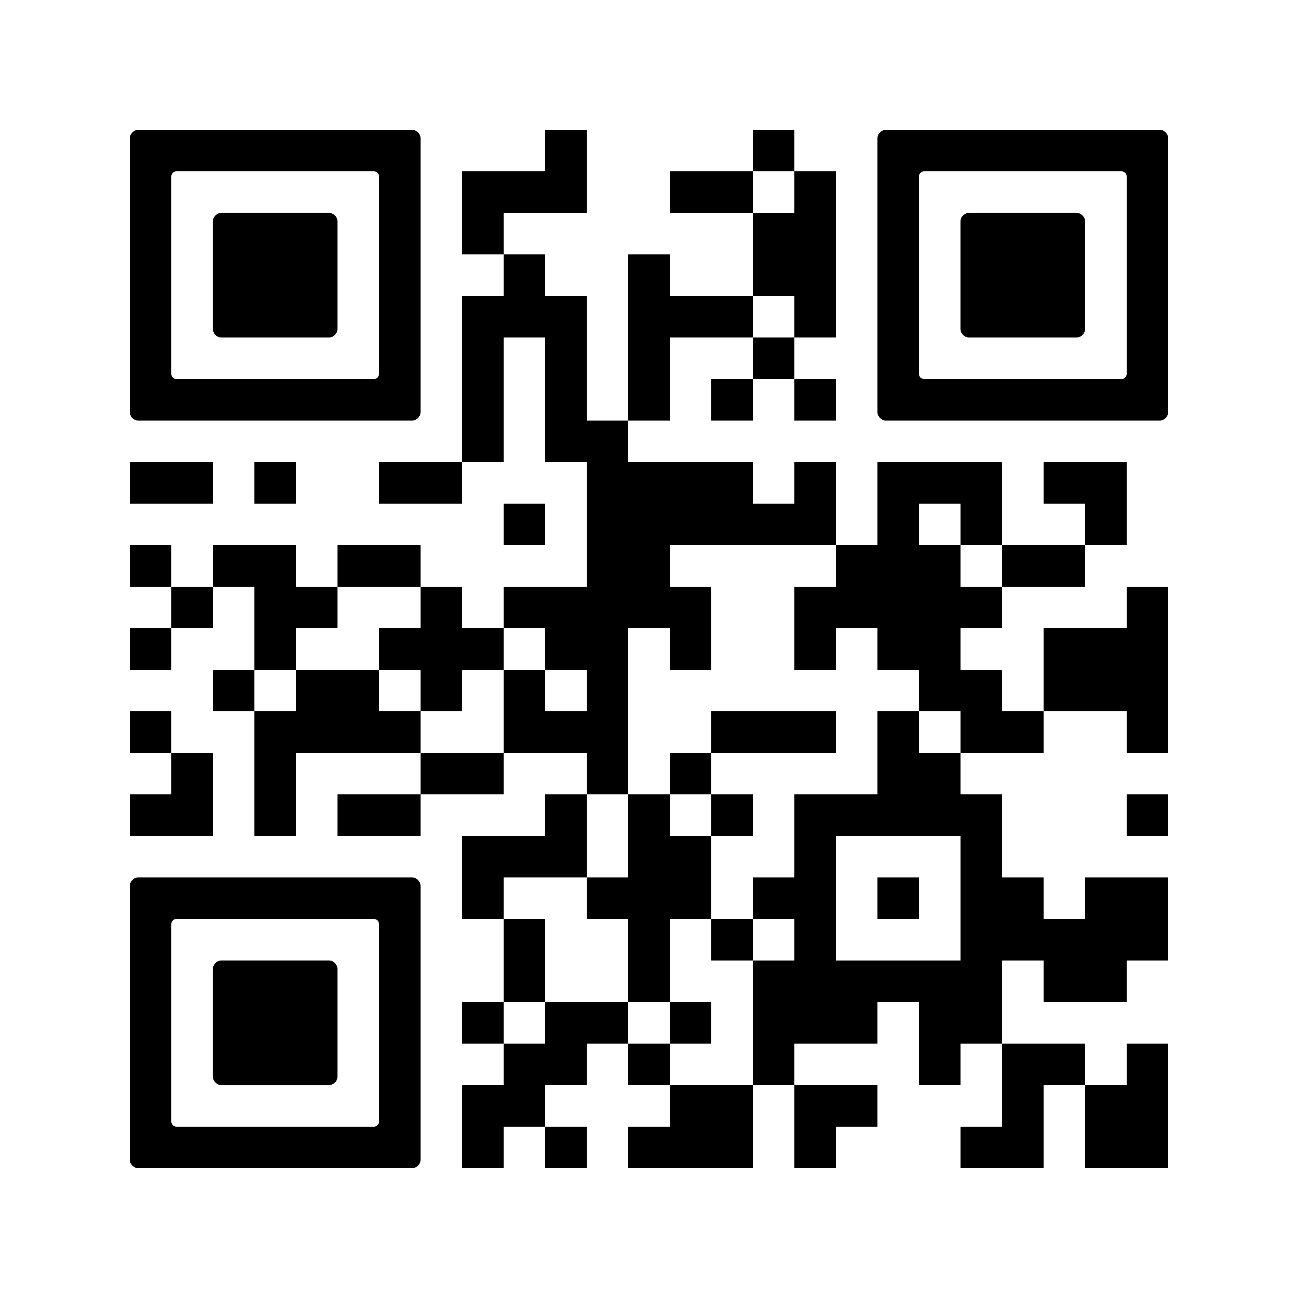
[ BROKER LOGO ]
agentFORWARD
Have You Seen These Reports?
Texas Quarterly Housing Report
Texas Homebuyers and Sellers Report
Texas International Homebuyers Report
Sales of Million-Dollar Homes in Texas Report
And more!
Check out all the reports at texasrealestate.com/members/research

Slide 7
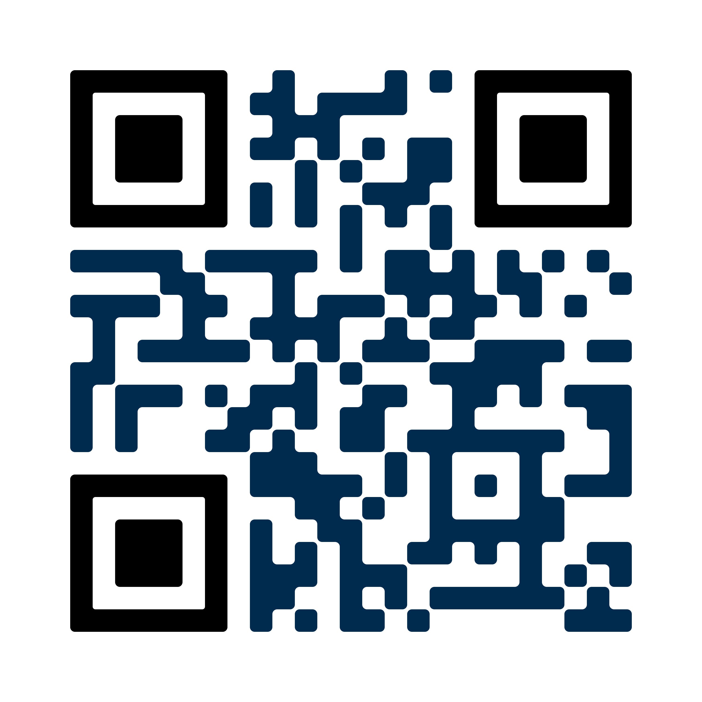
[ BROKER LOGO ]
agentFORWARD
2026 SHAPING TEXAS CONFERENCE
August 27-30
Grand Hyatt San Antonio River Walk
Reserve your spot at texasrealestate.com/conference

