Slide 1

agentFORWARD
[ BROKER LOGO ]
agentFORWARD
Ad Writing Guidelines

Slide 2

agentFORWARD
[ BROKER LOGO ]
11 Recommendations for Your Next Ad
From the Graduate, REALTOR® Institute Course
GRI Business Skills
From the Graduate, REALTOR® Institute Course, GRI Business Skills

Slide 3
agentFORWARD
[ BROKER LOGO ]
Here are some recommended business practices when writing ads:
From the Graduate, REALTOR® Institute Course, GRI Business Skills

Slide 4
agentFORWARD
[ BROKER LOGO ]
Write about benefits that entice the reader. Tie them into the enjoyment of the feature.
Target wants and needs that will appeal to buyers.
Include community benefits that address the quality of life that a buyer can expect.
Use descriptive terms that address benefits.
From the Graduate, REALTOR® Institute Course, GRI Business Skills

Slide 5
agentFORWARD
[ BROKER LOGO ]
Try to whet buyers’ appetites. Provide enough information to make them call. Leave out a couple of details that will prompt additional questions.
Make the ad reader-friendly. It should be short, simple, and easy to read. Bullets work better than sentences.
Avoid bait-and-switch tactics, and don’t distort facts.
Always include a call to action. You must make the phone ring.
From the Graduate, REALTOR® Institute Course, GRI Business Skills

Slide 6
agentFORWARD
[ BROKER LOGO ]
Include your name, your broker’s name, and the real estate company. Don’t forget to include that you’re a Texas REALTOR®.
Never cite a feature as new, totally redone, or good as new.
When citing acreage or square footage, say it is an approximate measure and include the source (e.g. approximately 2,000 square feet according to…)
From the Graduate, REALTOR® Institute Course, GRI Business Skills

Slide 7
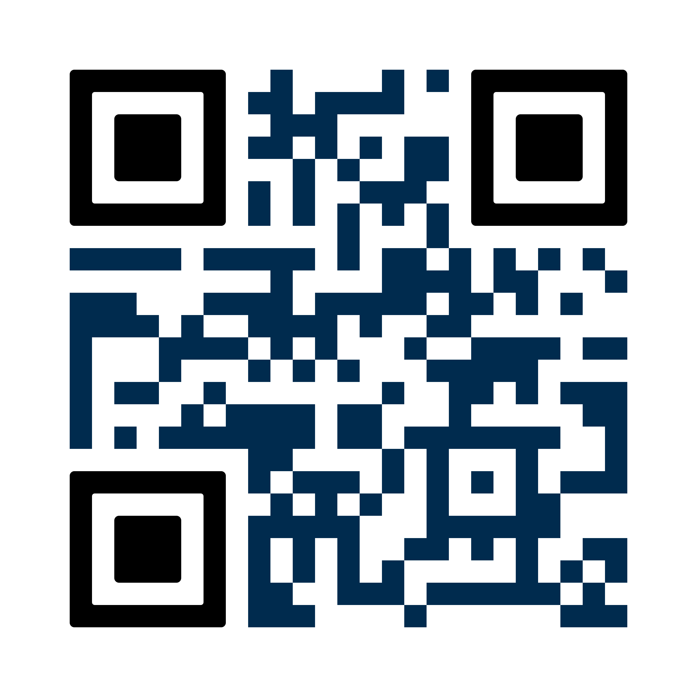
agentFORWARD
[ BROKER LOGO ]
For more tips like these, take the GRI Business Skills course and earn the Graduate, REALTOR® Institute designation.
94% of REALTORS® in Texas with their GRI designation recommend it to other REALTORS®. The GRI coursework includes information about contracts, marketing and business skills, and real estate brokerage.
FOR MORE INFORMATION, SCAN THIS QR CODE OR VISIT
texasrealestate.com/gri

