Slide 1

[ BROKER LOGO ]
agentFORWARD
September 2026 Updates + NAR Sales Meeting Playbook

Slide 2
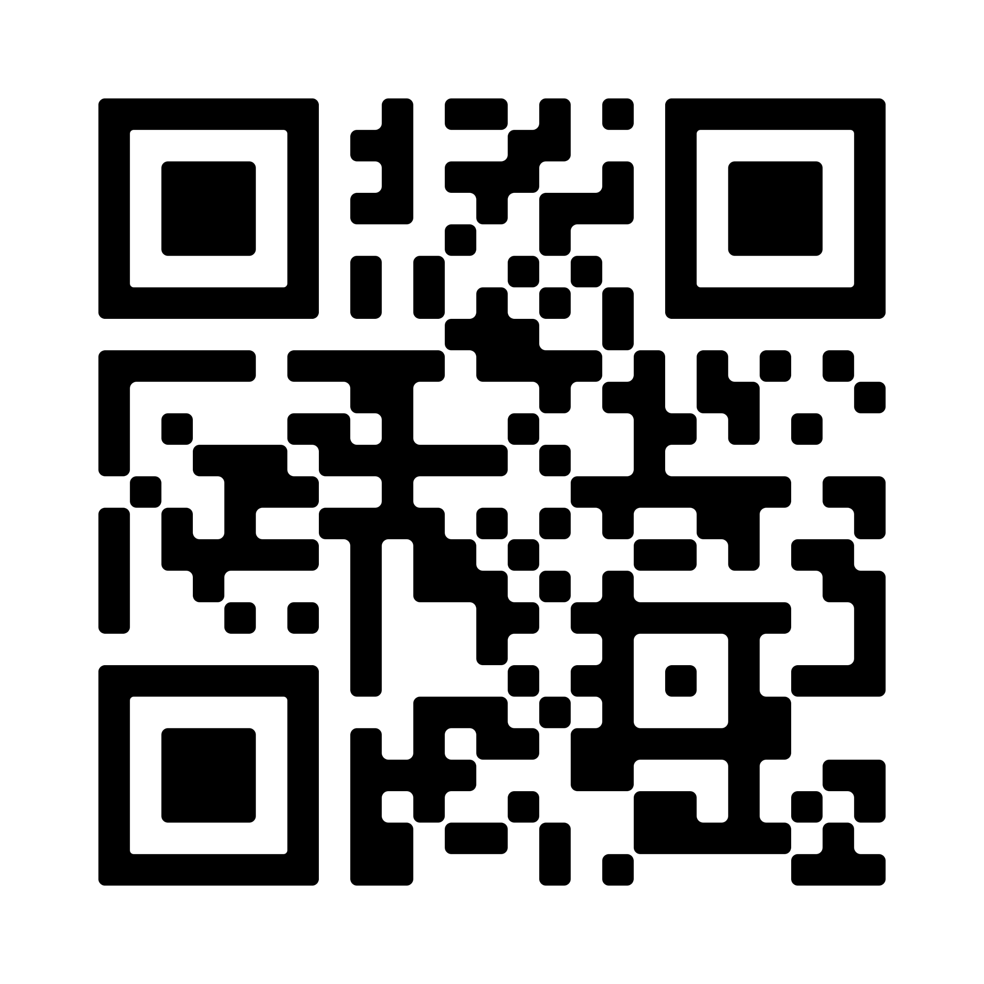
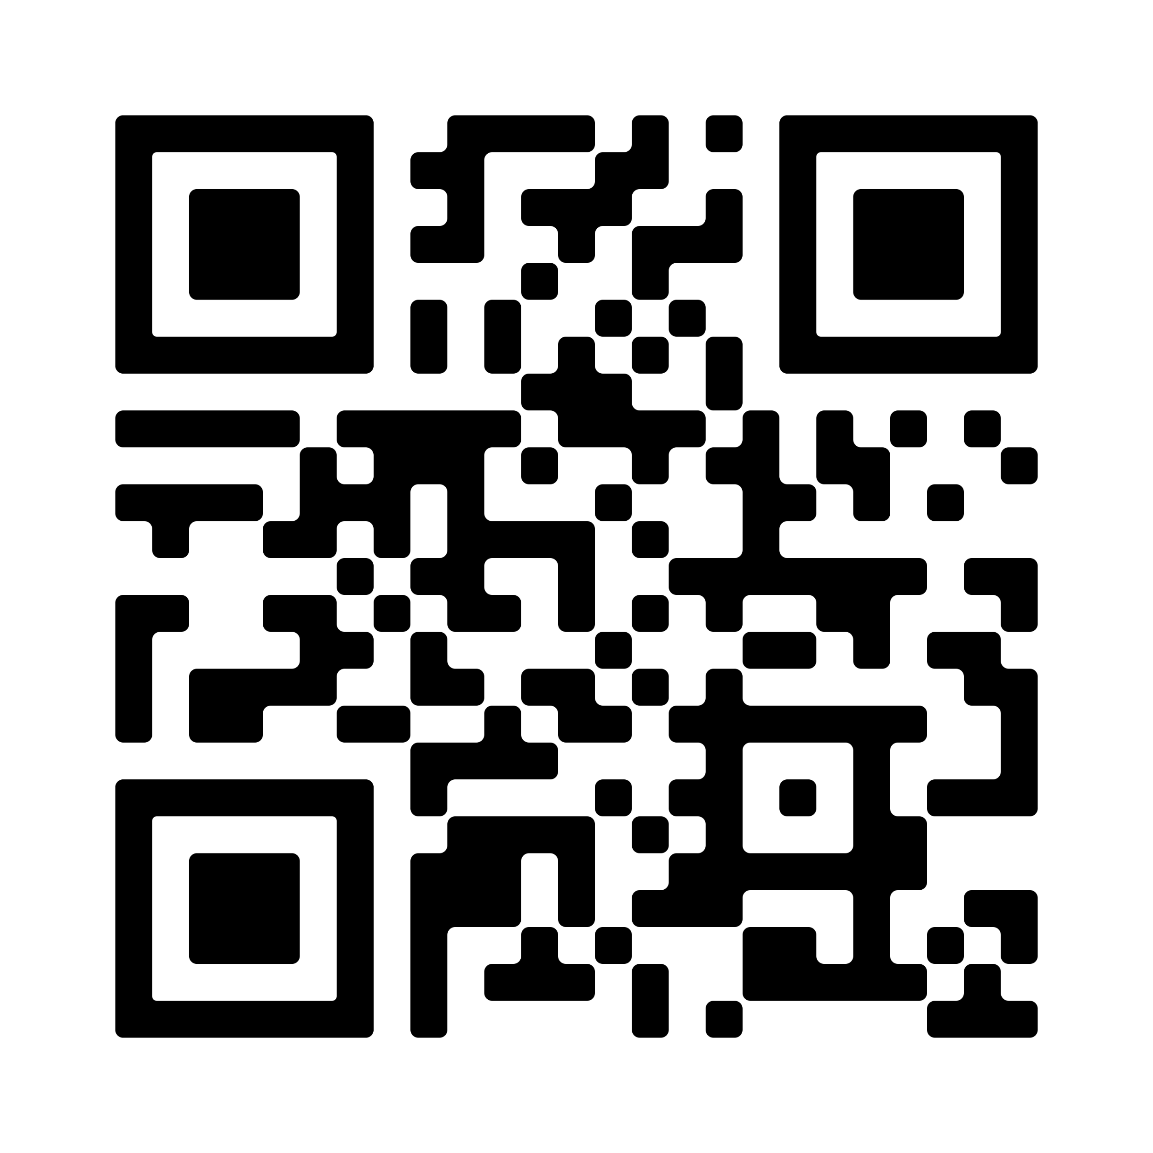

[ BROKER LOGO ]
agentFORWARD
Are You Ready for Changes to Appraisal Reporting?
Watch these videos to learn more
How UAD 3.6 Affects Your Agents & Your Business
The Biggest Appraisal Change in Years: What Every REALTOR® Needs to Know
vimeo.com/1225609462
vimeo.com/1215860663

Slide 3

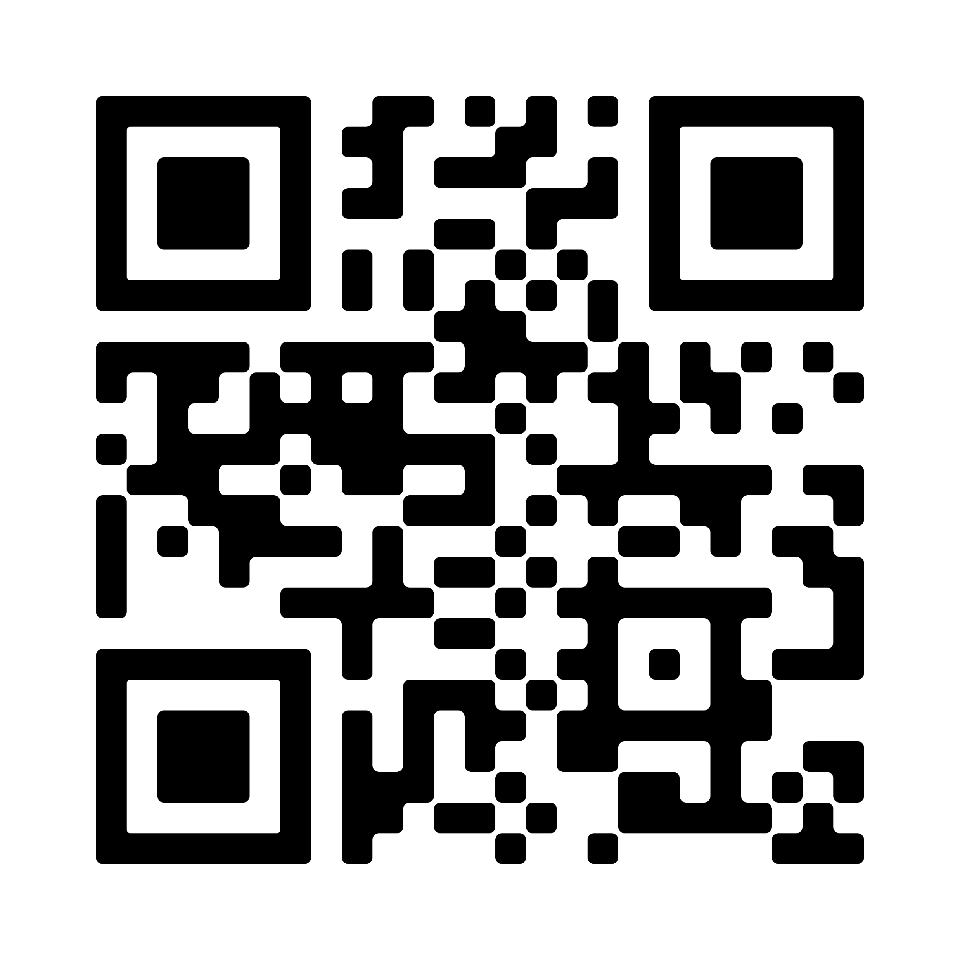
[ BROKER LOGO ]
agentFORWARD
New Member Benefits Video
Watch the video here or at
vimeo.com/1223032231

Slide 4
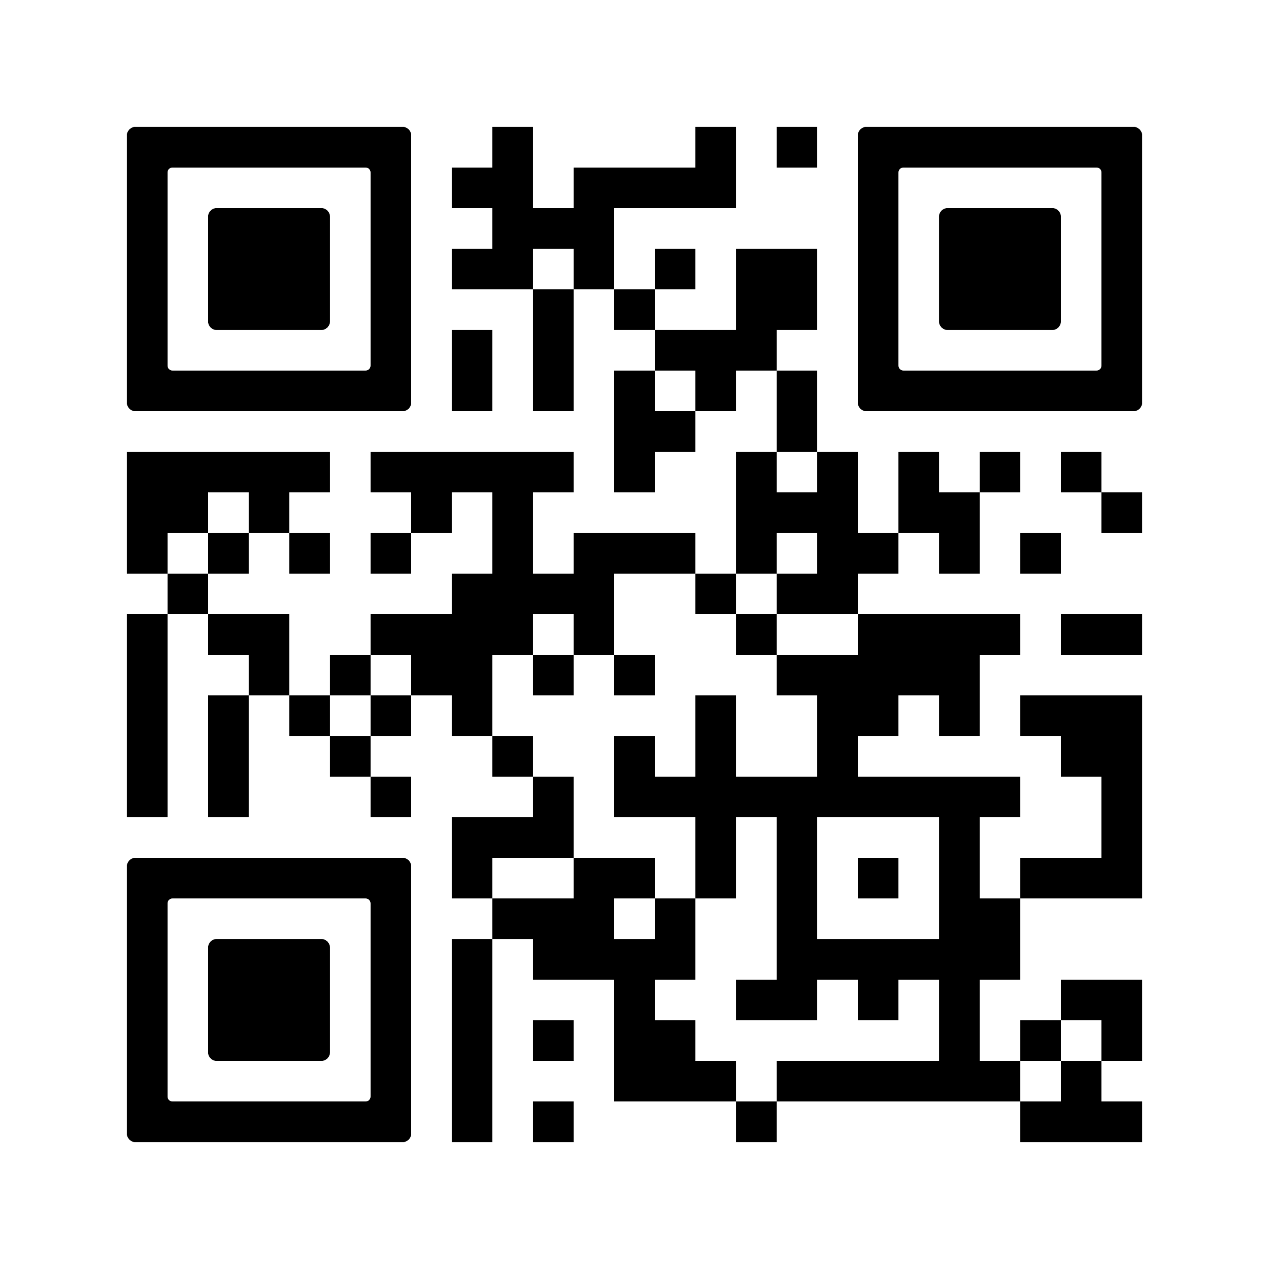
[ BROKER LOGO ]
agentFORWARD
Submit Awards Nominations Through November 16
William C. Jennings Award
REALTORS® to Watch Award
Texas REALTORS® Diversity & Fair Housing Award
Educator of the Year
Richard Miranda Global Achievement Award
Texas REALTORS® Good Neighbor Award
Tom D. Morton Award
Education Programs of the Year Award
texasrealestate.com/about-us/awards

Slide 5
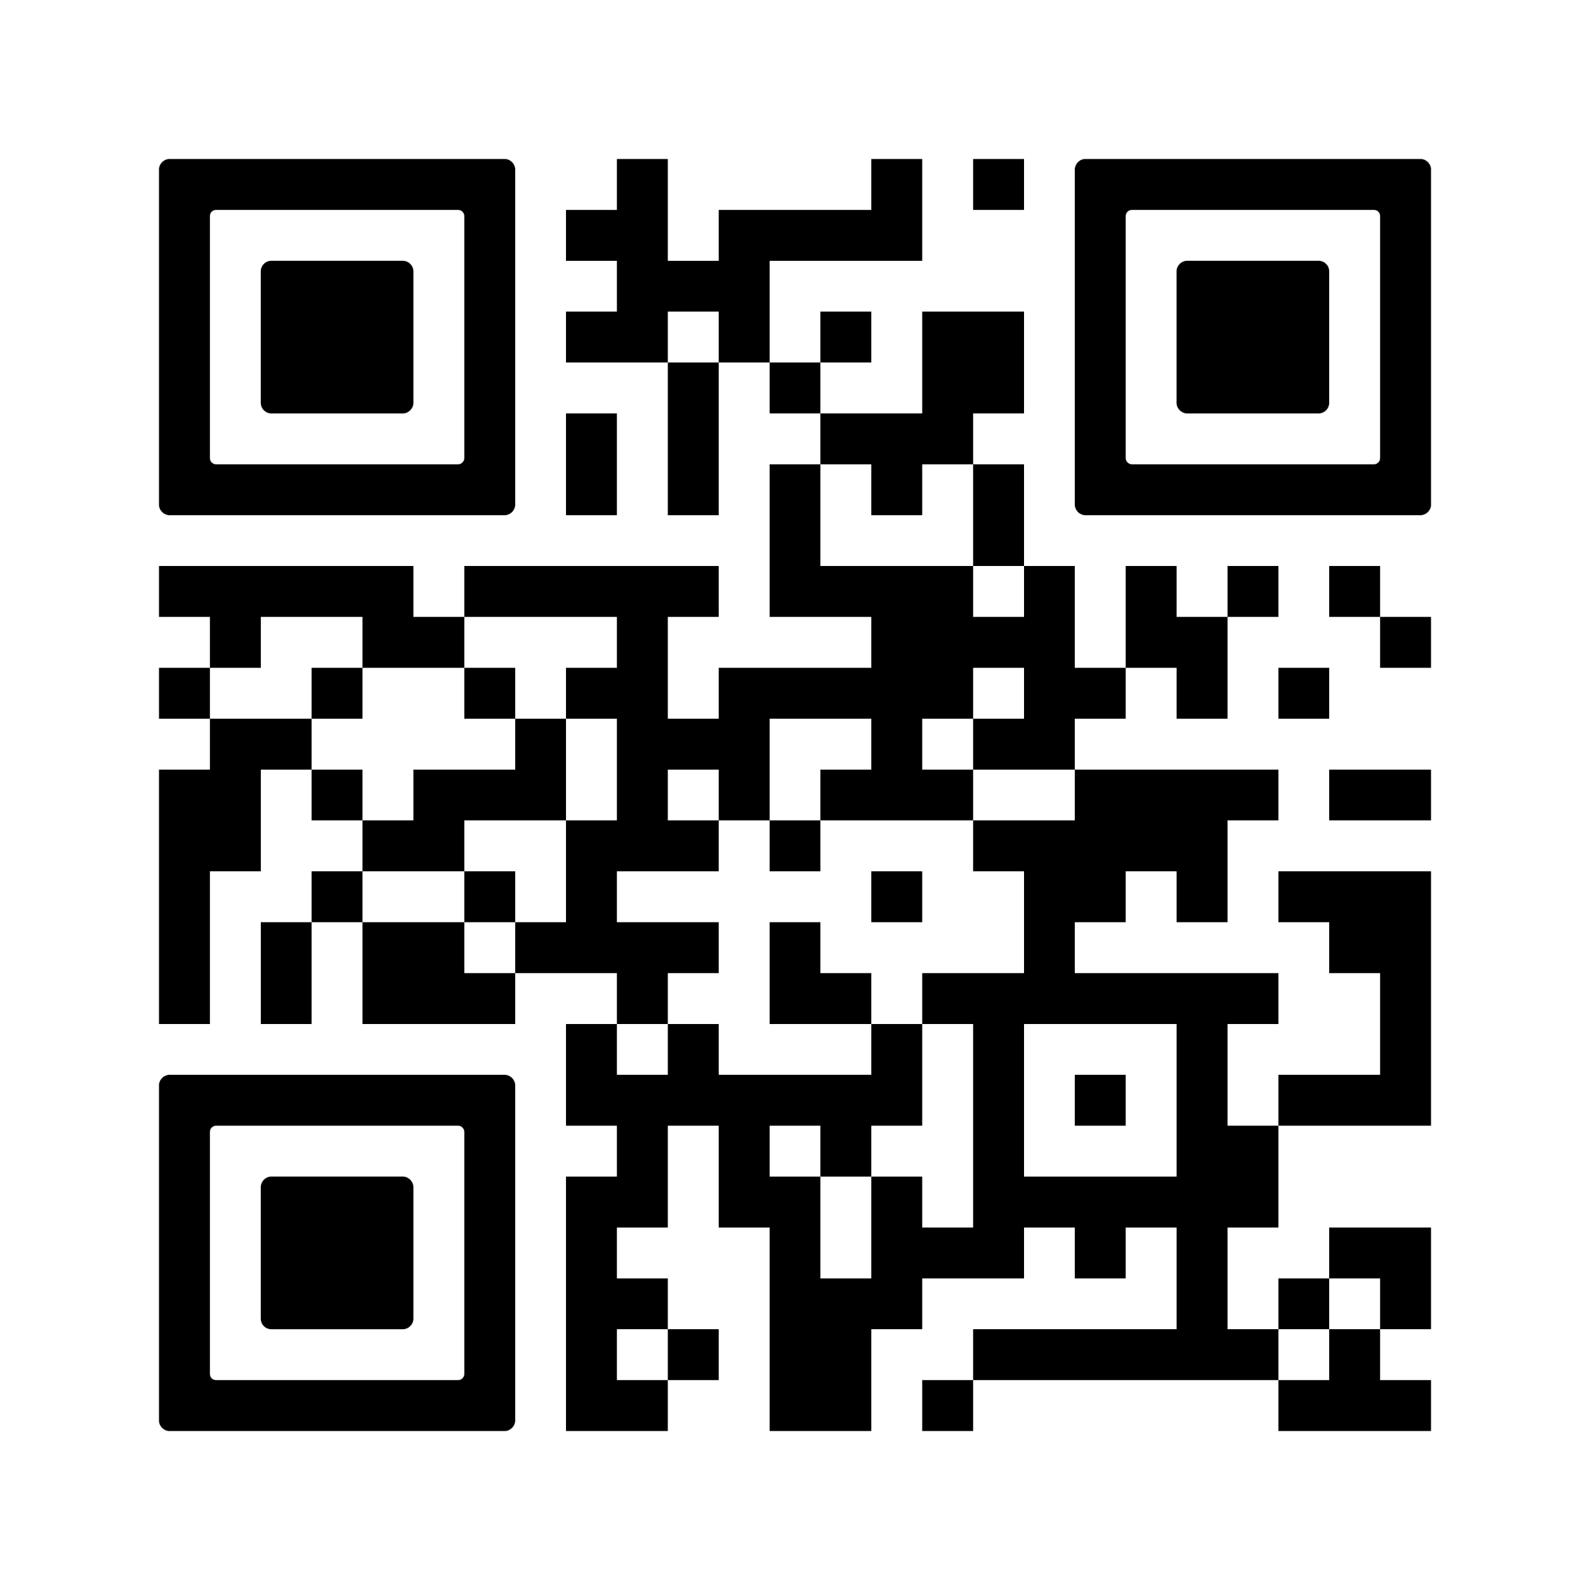
[ BROKER LOGO ]
agentFORWARD
Upcoming Webinars
September 24
Order in the Court: The Squatter Showdown
October 27
PetScreening Presents: Navigating Pet-Friendly Housing, Fair Housing Compliance, and Assistance Animals in Texas
December 16
The Power of Mentorship
texasrealestate.com/events

