Slide 1

[ BROKER LOGO ]
agentFORWARD
What Helps Properties Sell

Slide 2

[ BROKER LOGO ]
agentFORWARD
17 Conditions That Help A Property Sell
From the Graduate, REALTOR® Institute Course, GRI Business Skills

Slide 3
[ BROKER LOGO ]
agentFORWARD
The ability to sell a property is not related solely to price.
There are other conditions the seller can put in place that will offset the price to a degree and make the listing more sellable.
Other factors include:
From the Graduate, REALTOR® Institute Course, GRI Business Skills

Slide 4
[ BROKER LOGO ]
agentFORWARD
1. Priced below an obvious price break
2. Below-market interest rate
3. Owner financing available
4. Downpayment assistance
From the Graduate, REALTOR® Institute Course, GRI Business Skills

Slide 5
[ BROKER LOGO ]
agentFORWARD
5. Subsidize buyer closing costs
6. Ability to sell CV, FHA, and VA
7. Property rehabbed to an improved condition
8. Completion of critical repairs
From the Graduate, REALTOR® Institute Course, GRI Business Skills

Slide 6
[ BROKER LOGO ]
agentFORWARD
9. Permission to place online (including MLS)
10. Highly desirable appeal and location
11. Curb appeal outstrips competition
12. High accessibility of the property—lockbox and showing on short notice
From the Graduate, REALTOR® Institute Course, GRI Business Skills

Slide 7
[ BROKER LOGO ]
agentFORWARD
BEST PRACTICE #5
13. Residential service agreement (home warranty) offered
14. Immediate possession
15. Extra amenities included
Appliances that convey
Selling agent bonus or commission incentive
(remember any additional bonus must be disclosed and buyer must consent to selling agent receiving it)
From the Graduate, REALTOR® Institute Course, GRI Business Skills

Slide 8
[ BROKER LOGO ]
agentFORWARD
Overall saleability should be considered when taking a listing.
If the seller cannot offer a
significant number of items on this list, consider your ability to do your job effectively.
From the Graduate, REALTOR® Institute Course, GRI Business Skills

Slide 9
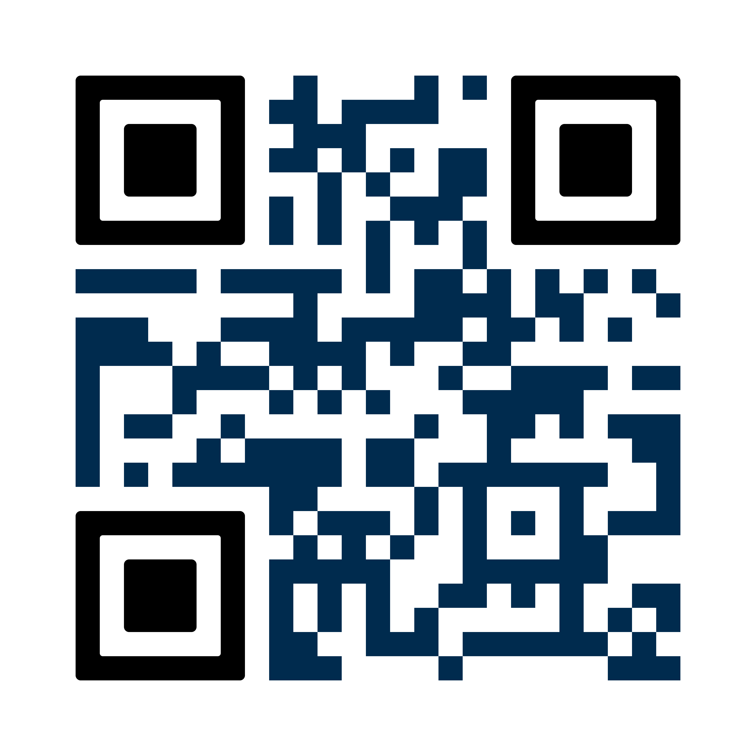
[ BROKER LOGO ]
agentFORWARD
For more tips like these, take the GRI Business Skills course and earn the Graduate, REALTOR® Institute designation.
94% of REALTORS® in Texas with their GRI designation recommend it to other REALTORS®. The GRI coursework includes information about contracts, marketing and business skills, and real estate brokerage.
FOR MORE INFORMATION, SCAN THIS QR CODE OR VISIT texasrealestate.com/gri

